Slide 1
OLYMPIC GAMES
Nikola Mičová, Sára Sokáčová

Slide 2
Contents
Olympic values
3
Citizenship
7
World ideals
9
Sustainable goals
11
Summary
13

Slide 3
Olympic values

Slide 4
Excellence
3
be the best you can
best ≠ 100%
everyone is perfect in their own way

Slide 5

Respect
3
yourself
rules
opponents
enviroment
public

Slide 6
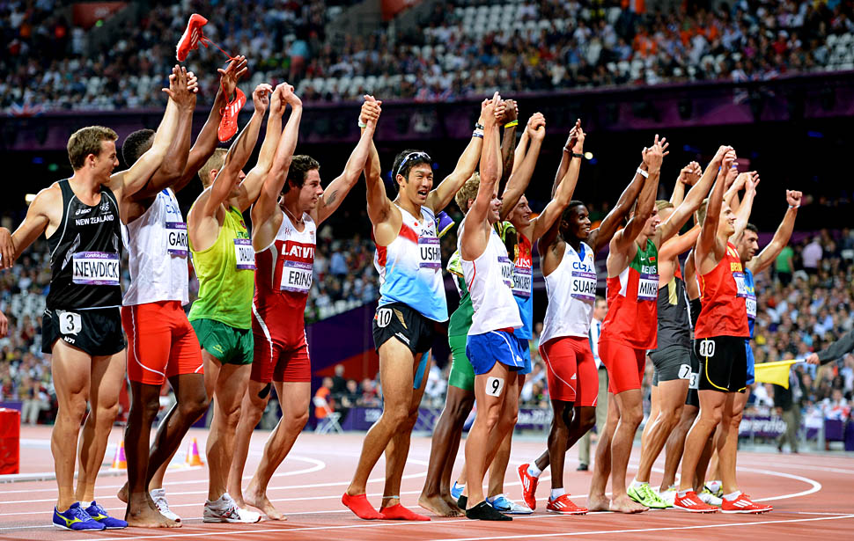
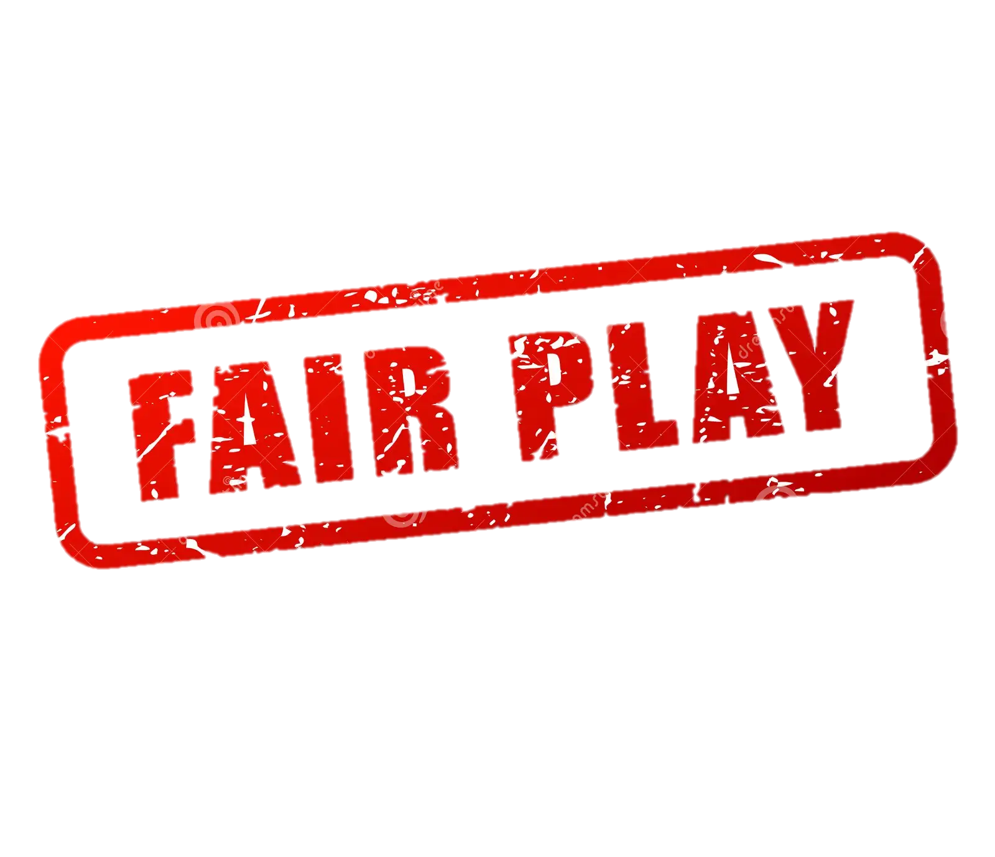
Friendship
3
fair play
bring people together

Slide 7

Citizenship

Slide 8
Citizenship and OG
3
Representation and national identity
Promotion of peace and unity
Legacy and inspiration
Cultural exchange and understanding
Global citizenship and sportsmanship

Slide 9
World ideals

Slide 10
World ideals and OG
spirit of friendship
fair play = equality and mutual respect
human rights

Slide 11
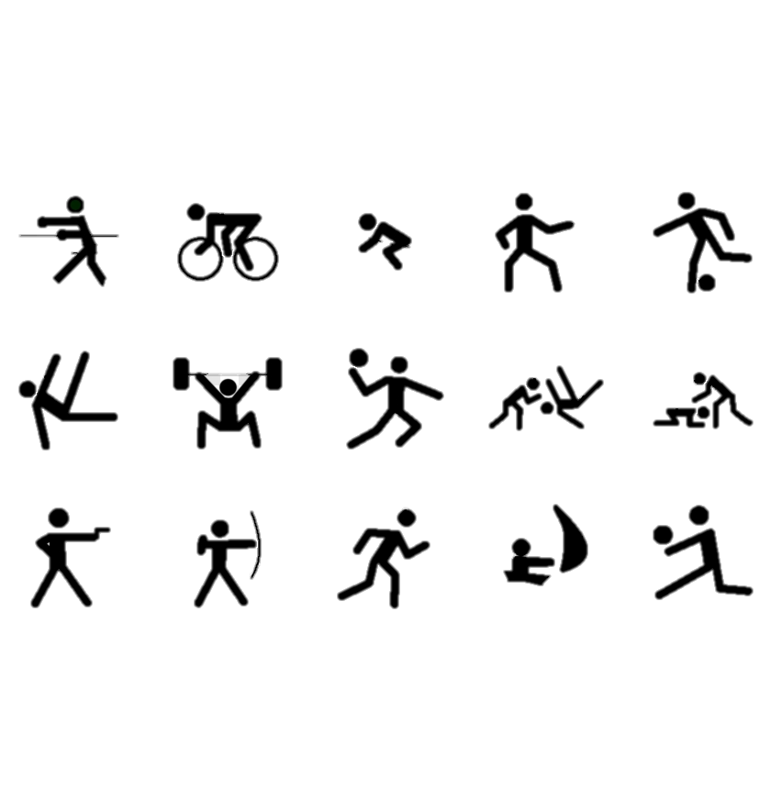
Sustainable goals

Slide 12
Sustainable goals and OG
PEACE
JUSTICE
STRONG INSTITUTIONS
absence of violance and conflicts within and between nations
Olympic Truce
fair play
anti–doping measures
ethical behaviour
no discrimination
human rights, security, effective control
IOC and NOCs

Slide 13
Summary
the Olympic Games serve as powerful platform to promote and embody world ideals
through Olympic values the OG demostrate the positive impact of sports in fostering a more peaceful and fair world
​

Slide 14

Thank you for your attention

