Slide 1
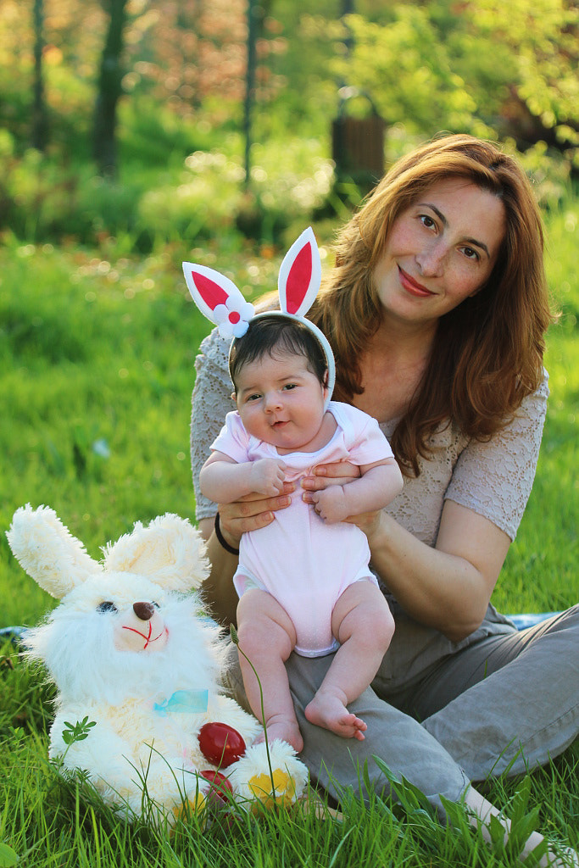
Mothering group’s
Emma, Ellen & Milla

Slide 2
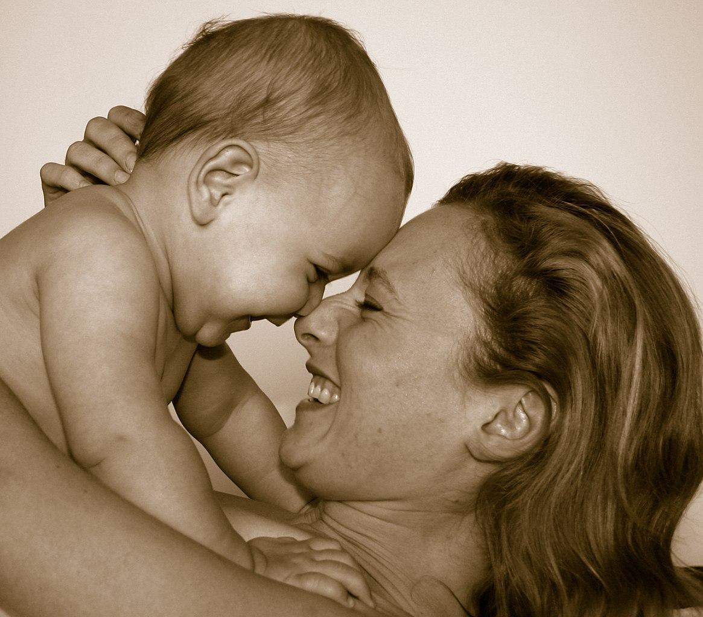
What are mothering group’s?
Mothering group’s are a group’s where new mother’s can get together and discuss things about motherhood.
The mom’s can ask questions about things that they don’t understand, ask for advice on things they are new too or open up about hardships that they have had.

Slide 3
What are the groups good for?
New mom’s can feel embarrassed asking questions about “normal” things regarding the baby’s well being. Mothering groups can be a safe place for every kind of questions.
Mom’s that already have experience in having a child, can attend the mothering groups and give tip’s for the newer mothers.

Slide 4
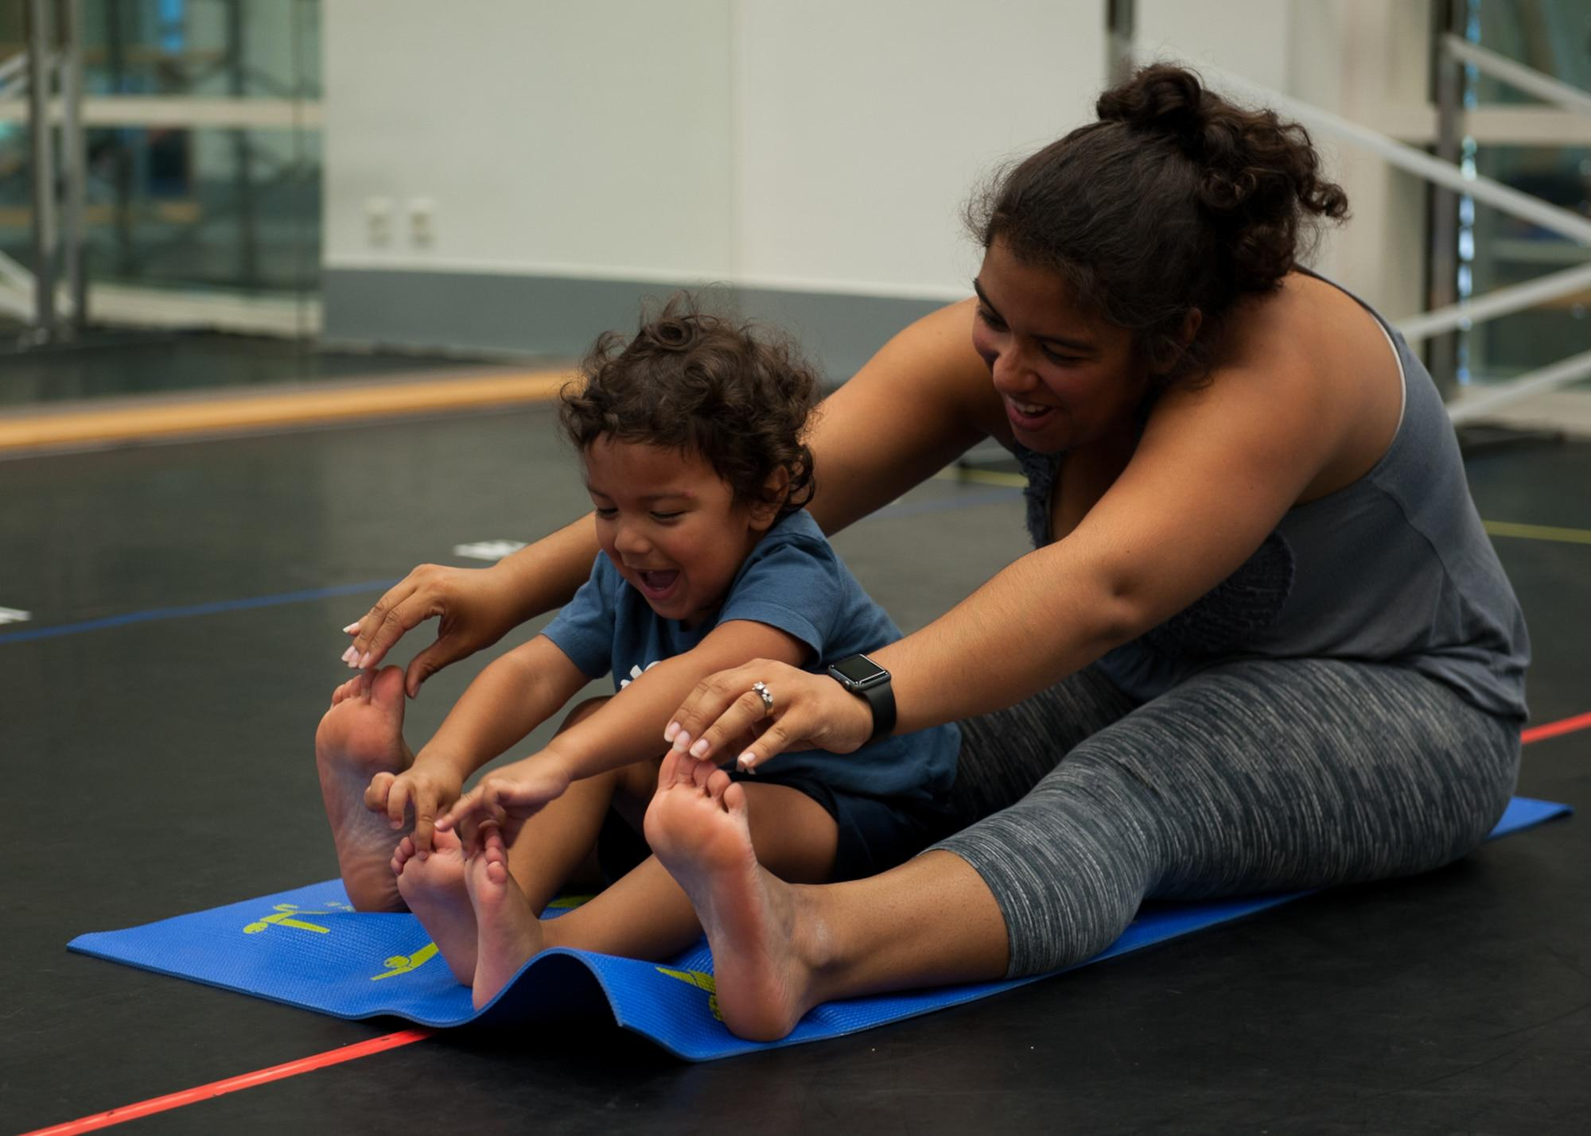
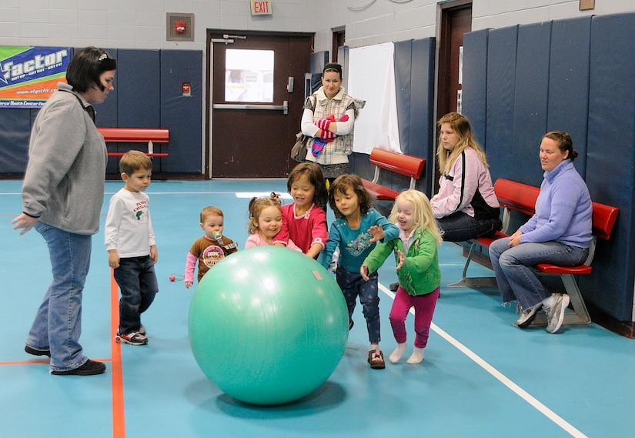
Does the child benefit from these groups?
While the parent is talking with other parents. The children can play with each other, this way the child will develop it’s social skills.
During the group meetings, there is usually activities that help with bonding between the child and the mother.
Great examples are
mommy and me yoga
mommy and me storytime
mommy and me music class

Slide 5
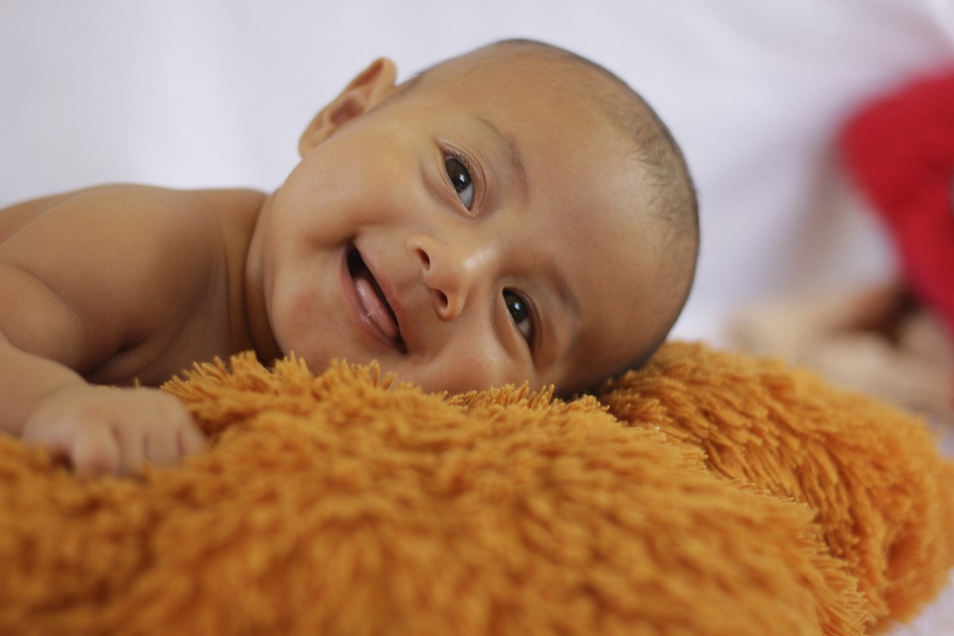
who organises mothering group’s?
In Finland there are many different organisations that provide mommy and me groups. For an example.
Mannerheimin Lastensuojelu Liitto
Helsinkis city
Different churches

Slide 6
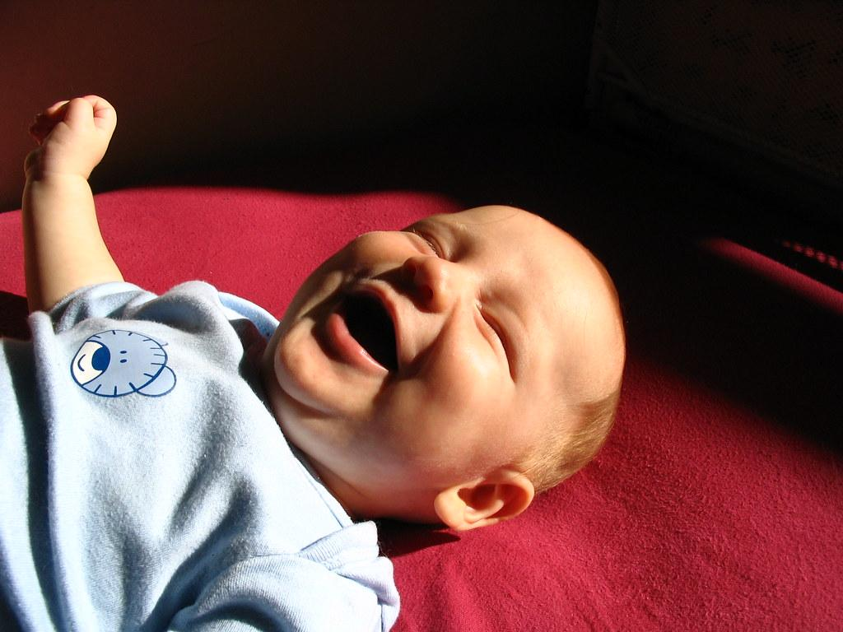
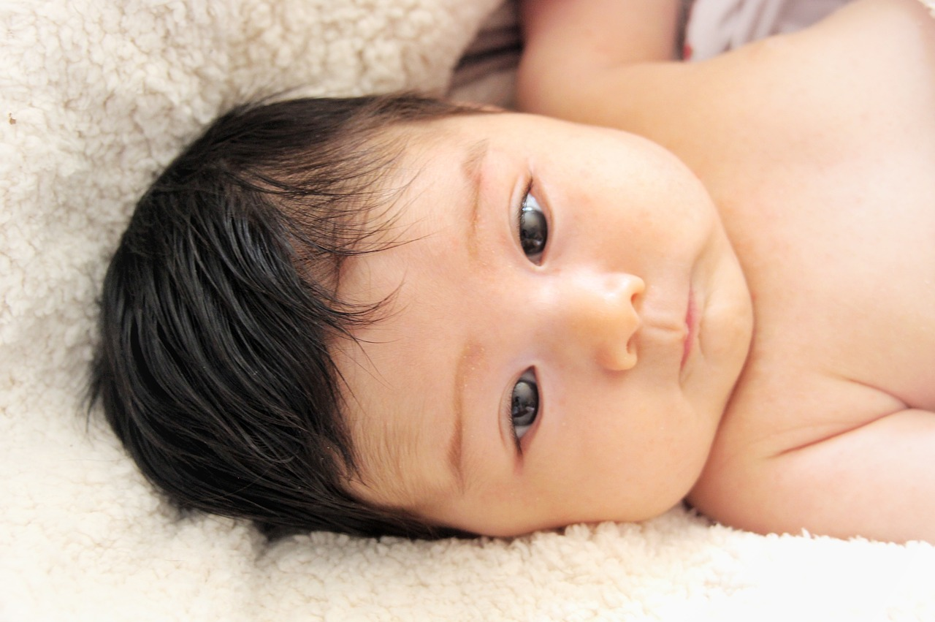
Sources
mll.fi
hel.fi

