Slide 1
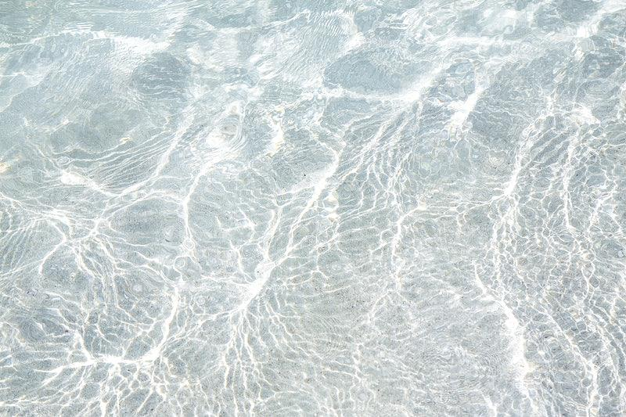
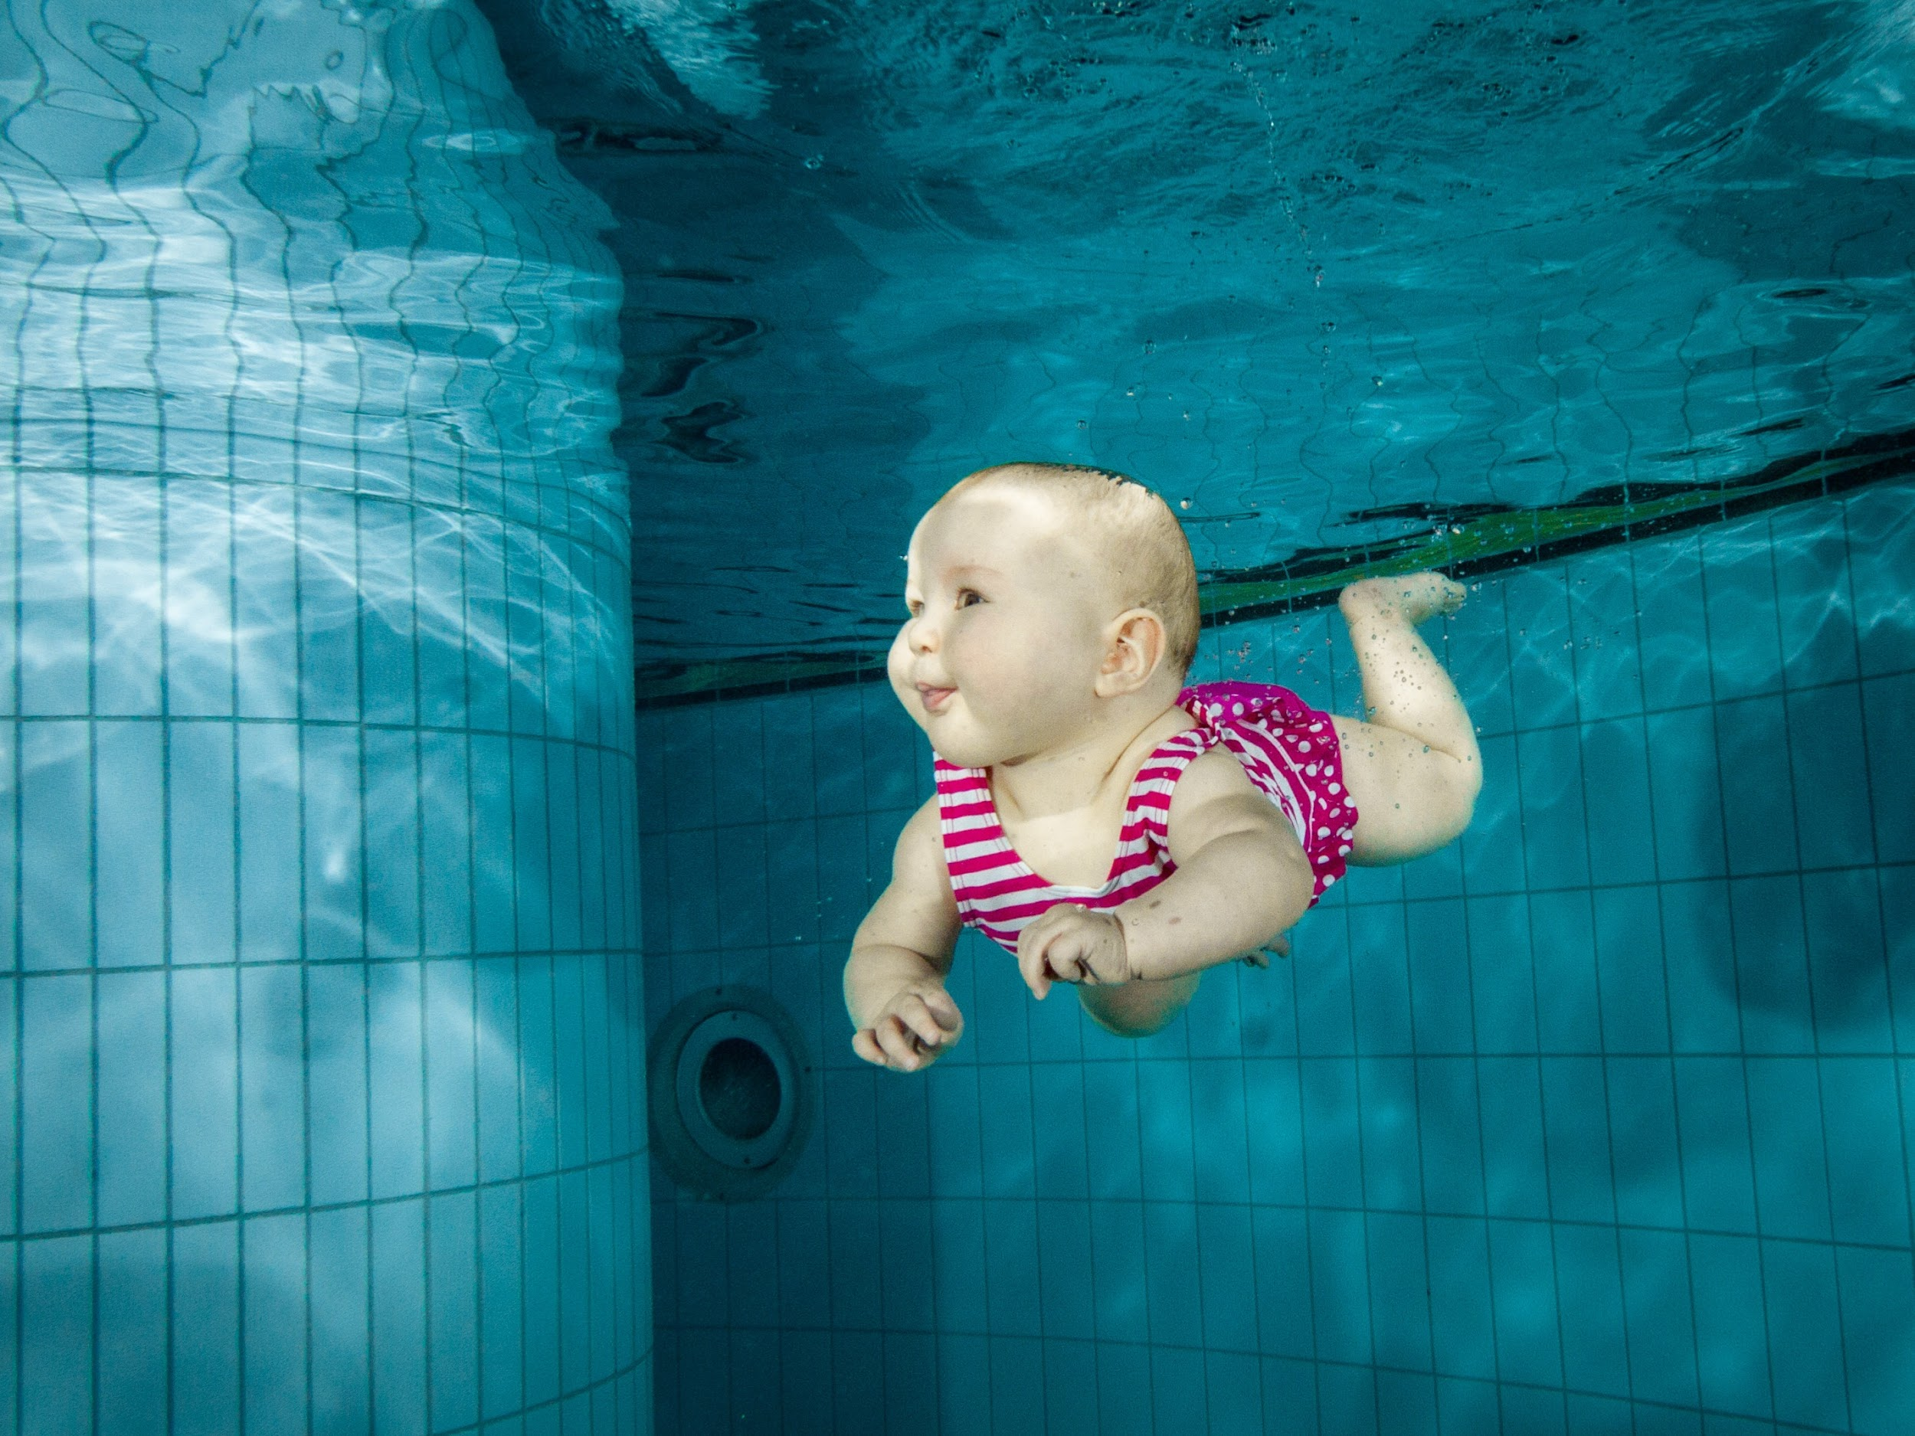
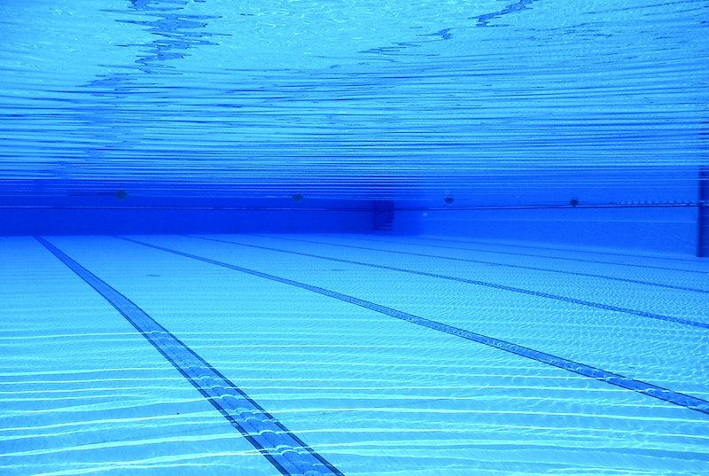
Baby Swimming
Lala ja Mimi 22A

Slide 2
What is baby swimming?
-Babies can go into water from birth, but they can’t control their temperature like adults. That’s why it’s important to make sure they don’t get cold. It’s generally best to wait until the baby is around 2 months old.
-Swimming strengthens their hearts and body parts. Water is also relaxing for babies.
-Baby swimming is a hobby for the whole family. The main thing is not to teach baby swimming itself. Most important is getting friendly with water and diving.

Slide 3
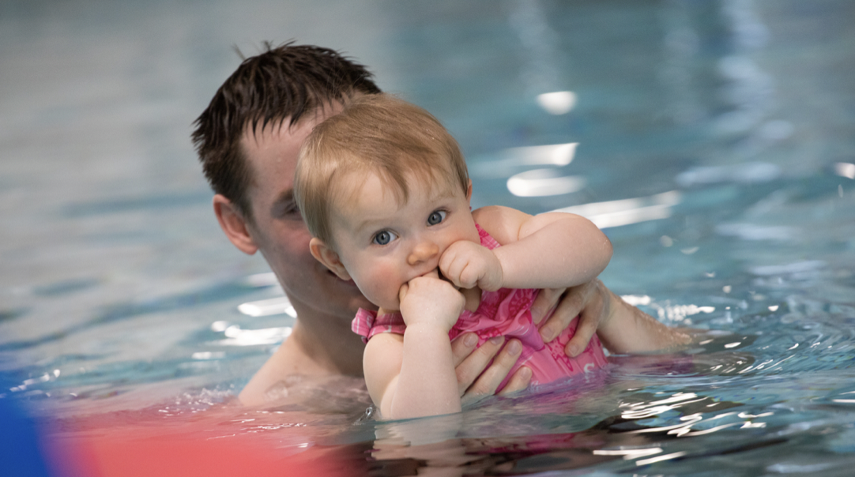
Finnish baby swimming organizations
-THL
-FSL= Finnish Swimming Teaching and Lifesaving Federation.
-Finnish Swimming Federation

Slide 4
Sources
-Pikkudelfiinit
-Suomen uimaopetus- ja pelastusliitto
-THL

