Slide 1
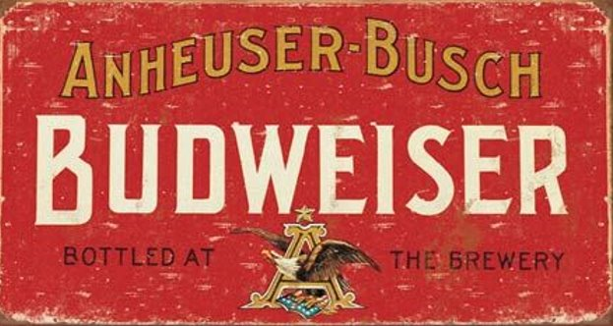
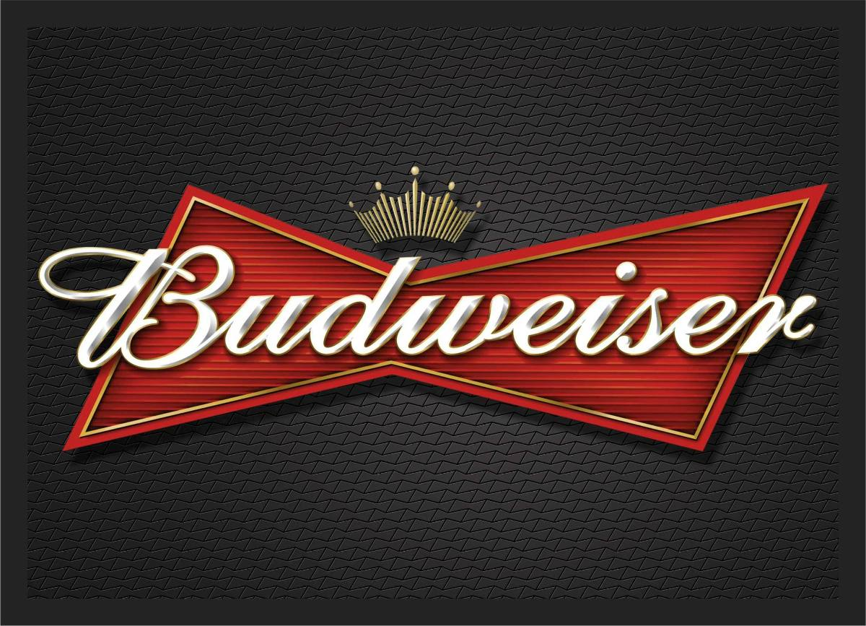
DOES TRADITION STILL REMAIN?

Slide 2
INTRODUCTION
Back in the 1950s, women were conformed with clear gender roles. Popular culture, vintage ads, and mass media were only reinforcing the messages of traditional ideals with patterns of repression and sexualization of women by men.
We chose the brand Budweiser, in honor of International Women’s Day, and revisited three of their beer ads from the ’50s and ’60s that they are not exactly proud of. The outdated ads portrayed objectified women in a subservient role to their husbands. But media and advertising was only a reflection of the world they lived in.

Slide 3
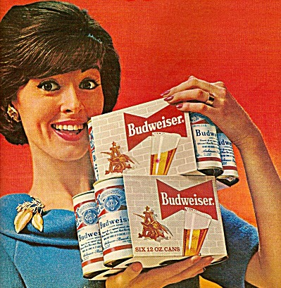
BUDWEISER FROM OLD-FASHIONED TO INNOVATIVE
Monica Rustgi, the vice president of marketing for Budweiser, said it was the brand’s “responsibility” to update the ads.
She added that Budweiser has begun a “long-term partnership” with #SeeHer, an initiative started by the Association of National Advertisers which aims for more accurate representation of women in the media.

Slide 4
BUDWEISER FROM OLD-FASHIONED TO INNOVATIVE
“As a leader in advertising, it’s our responsibility to showcase women in more balanced and empowered roles,” said Rustgi. “We are proud to officially announce our long-term partnership with #SeeHer to better inform and evaluate our future creative.”

Slide 5
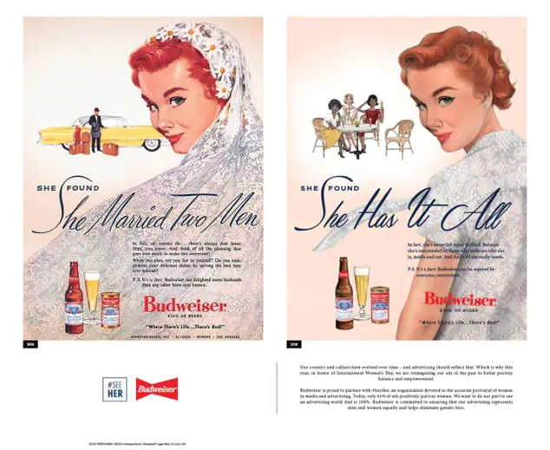
BUDWEISER CORRECTS OLD SEXIST ADS IN HONOR OF INTERNATIONAL WOMEN'S DAY
A slogan on the old ad from 1956 which reads, “She found she married two men” is replaced with an empowering one: “She found she has it all.”

Slide 6
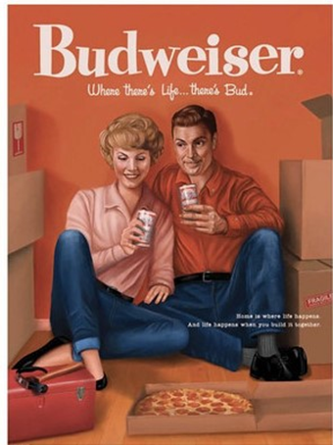
BUDWEISER ADAPTS ITS SEXIST ADS FROM THE 50S AND 60S TO 2019
A reprinted ad from 1958 shows a couple enjoying pizza and beer together and reads, “Home is where life happens, and life happens when you build it together,” while the original depicts a woman serving a beer to her working husband.

Slide 7
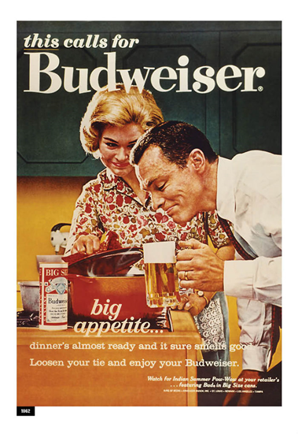
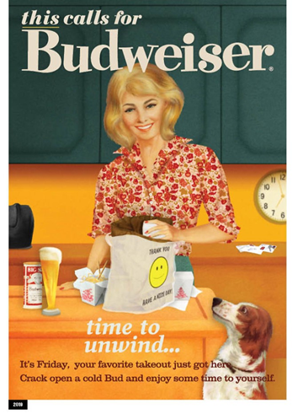
BUDWEISER CORRECTS ADS FROM THE 60S TO 2019
The last updated ad from 1960, where a woman had just prepared dinner for her husband and served him a beer, now shows the same woman enjoying her evening and reads, “It’s Friday, your favorite takeout just got here. Crack open a cold Bud and enjoy some time to yourself.”

Slide 8
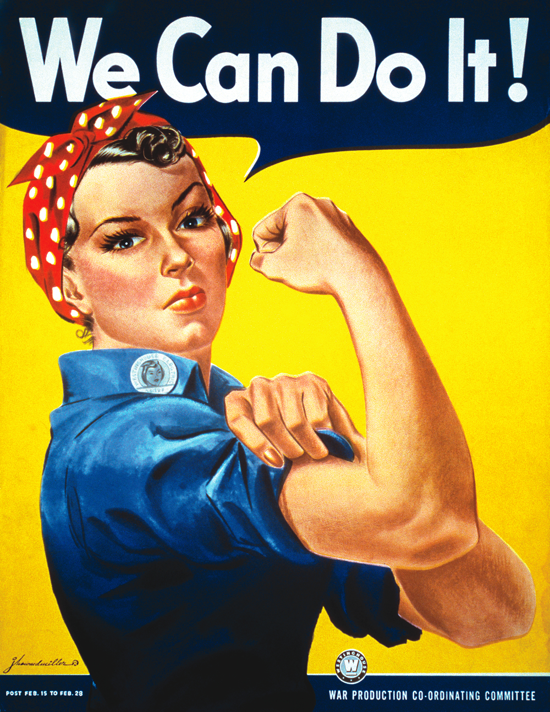
CONCLUSION
Although today’s reality is not perfect, we’ve come a long way in the battle with gender stereotypes and sexism, and Budweiser took an opportunity to celebrate this and course-correct its company policy by modernizing it and showcasing gender balance and women’s empowerment.

