Slide 1
Communication Do we appreciate what we have?
Aims: - to identify positive and negative aspects of their personalities
- to learn how to improve the negative aspects and diminish the negative ones
- to become aware of how each one’s personality influences the decisions taken in life
- to analyze and solve a real life situation.
Students work individually and then in groups
They present their work in the class to their colleagues and then work on the case study individually.
Their opinions are supported by arguments.

Slide 2
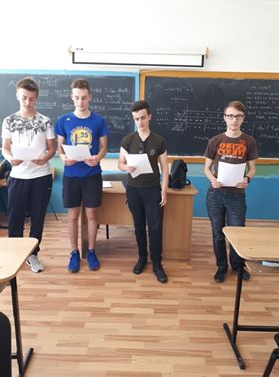

Slide 3
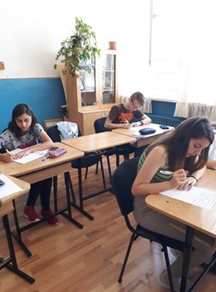
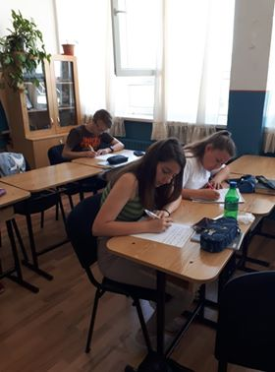

Slide 4
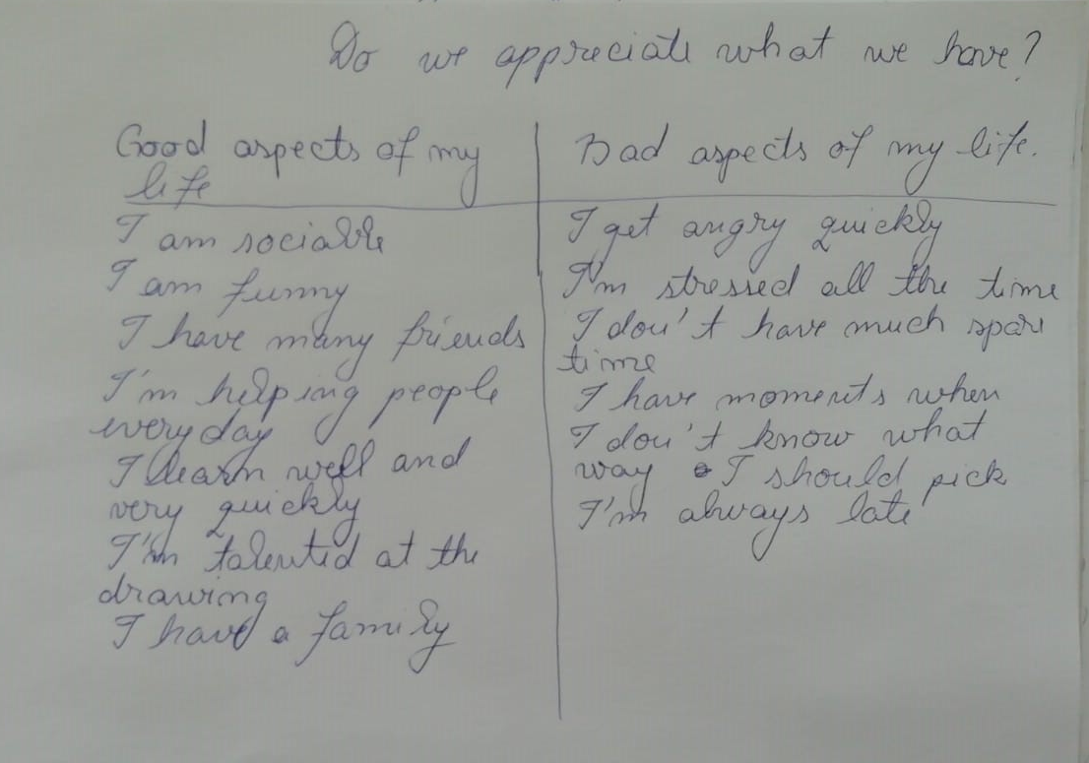
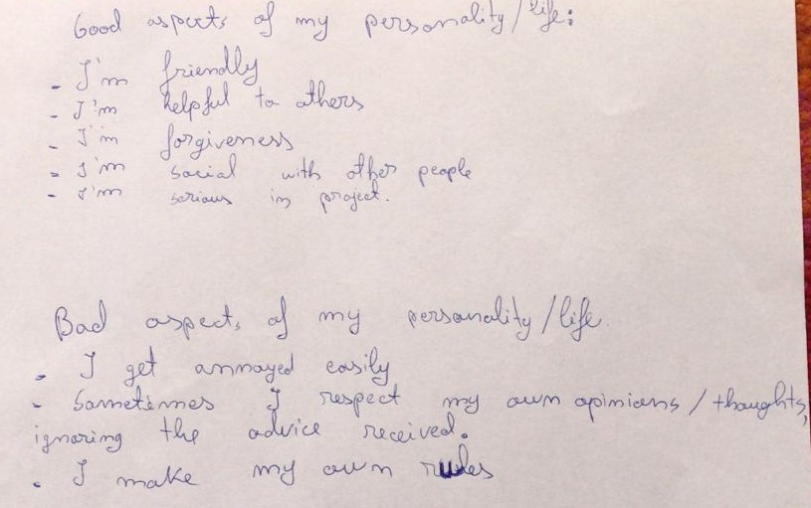

Slide 5
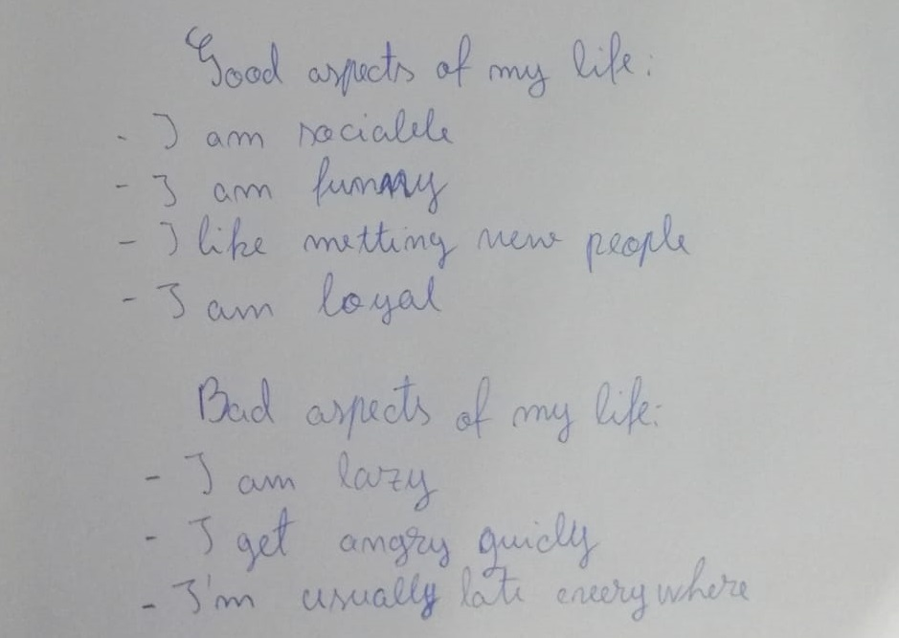
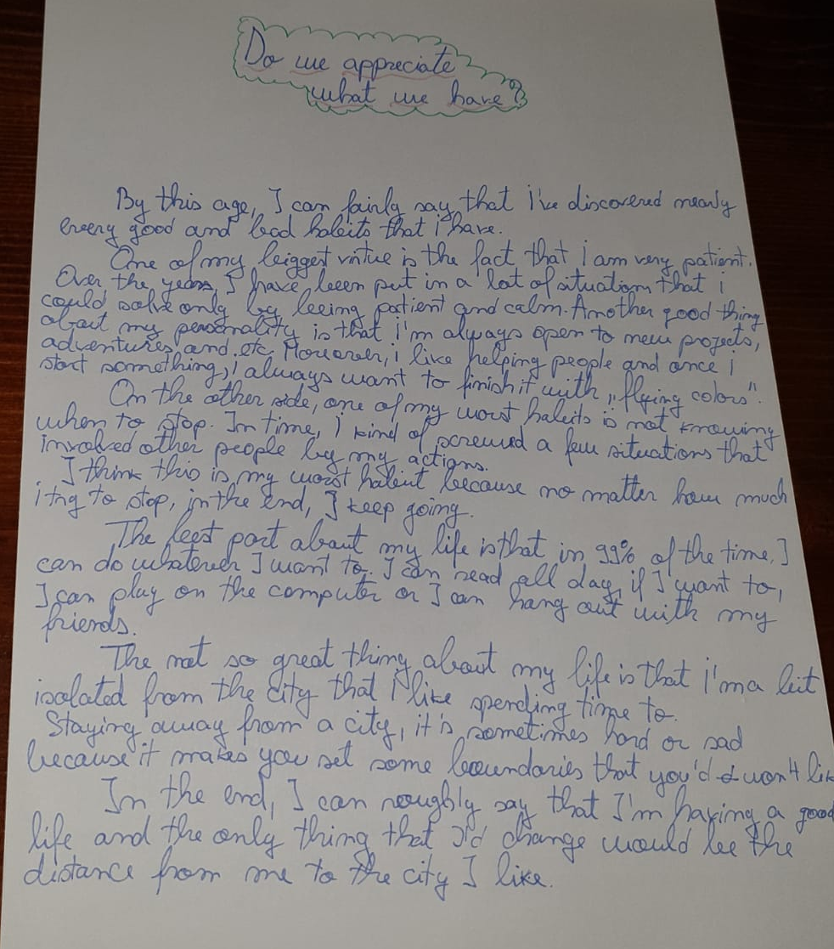
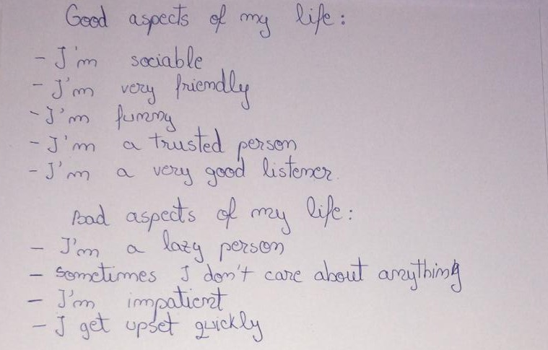

Slide 6
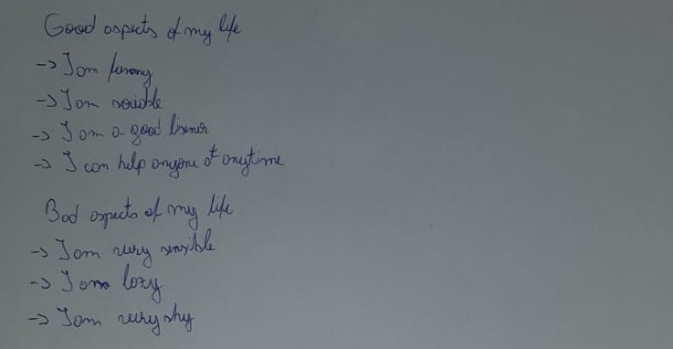
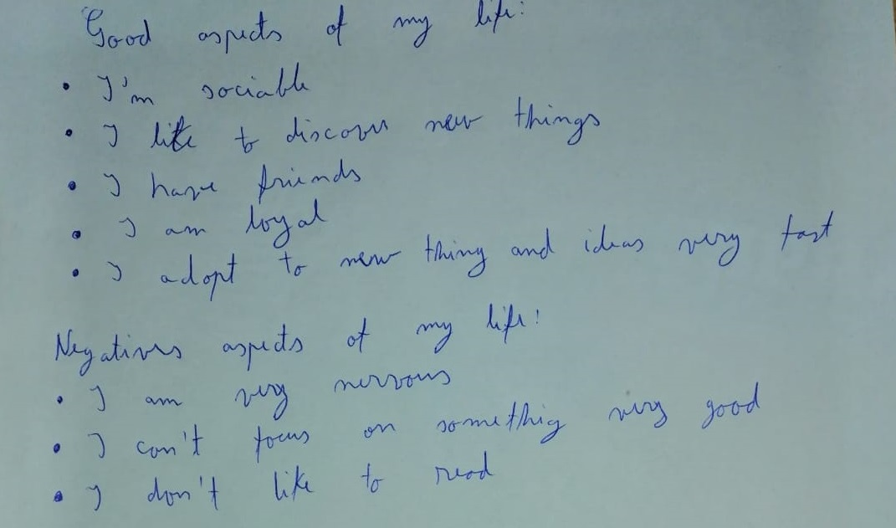

Slide 7
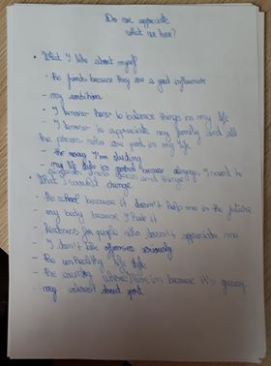
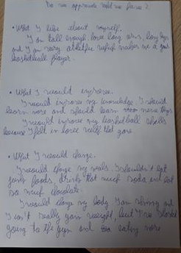
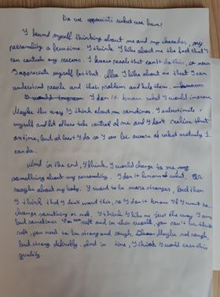

Slide 8
Case study
Nowadays in Romania, more and more students decide to drop off studies just before they are one step away from graduation. And they can’t be convinced to change their minds. What do you think this is the case and what advice would you give to such a student?

Slide 9
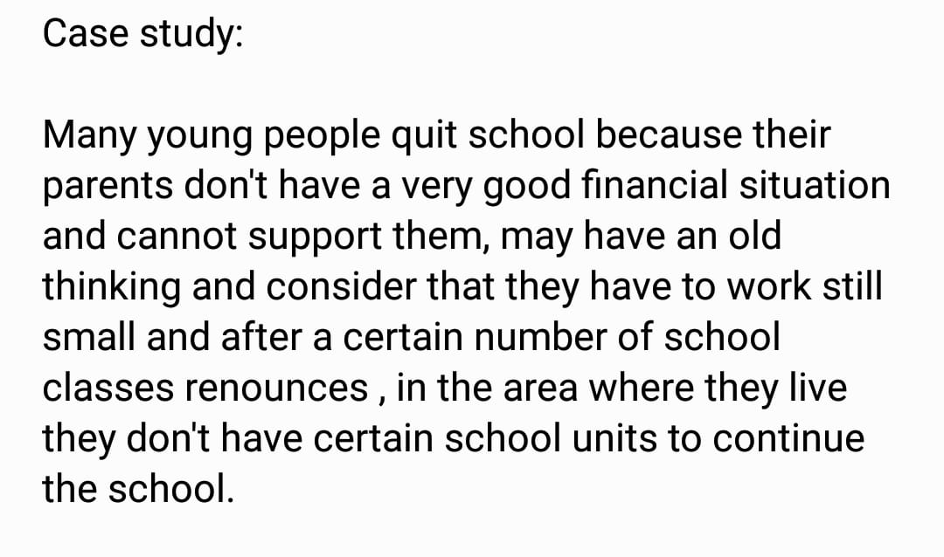

Slide 10
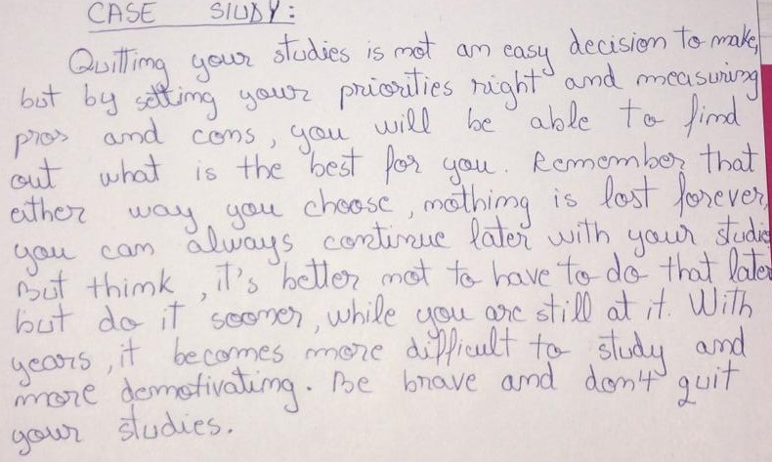

Slide 11
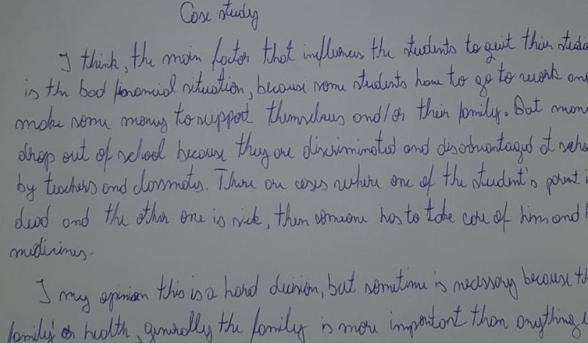

Slide 12
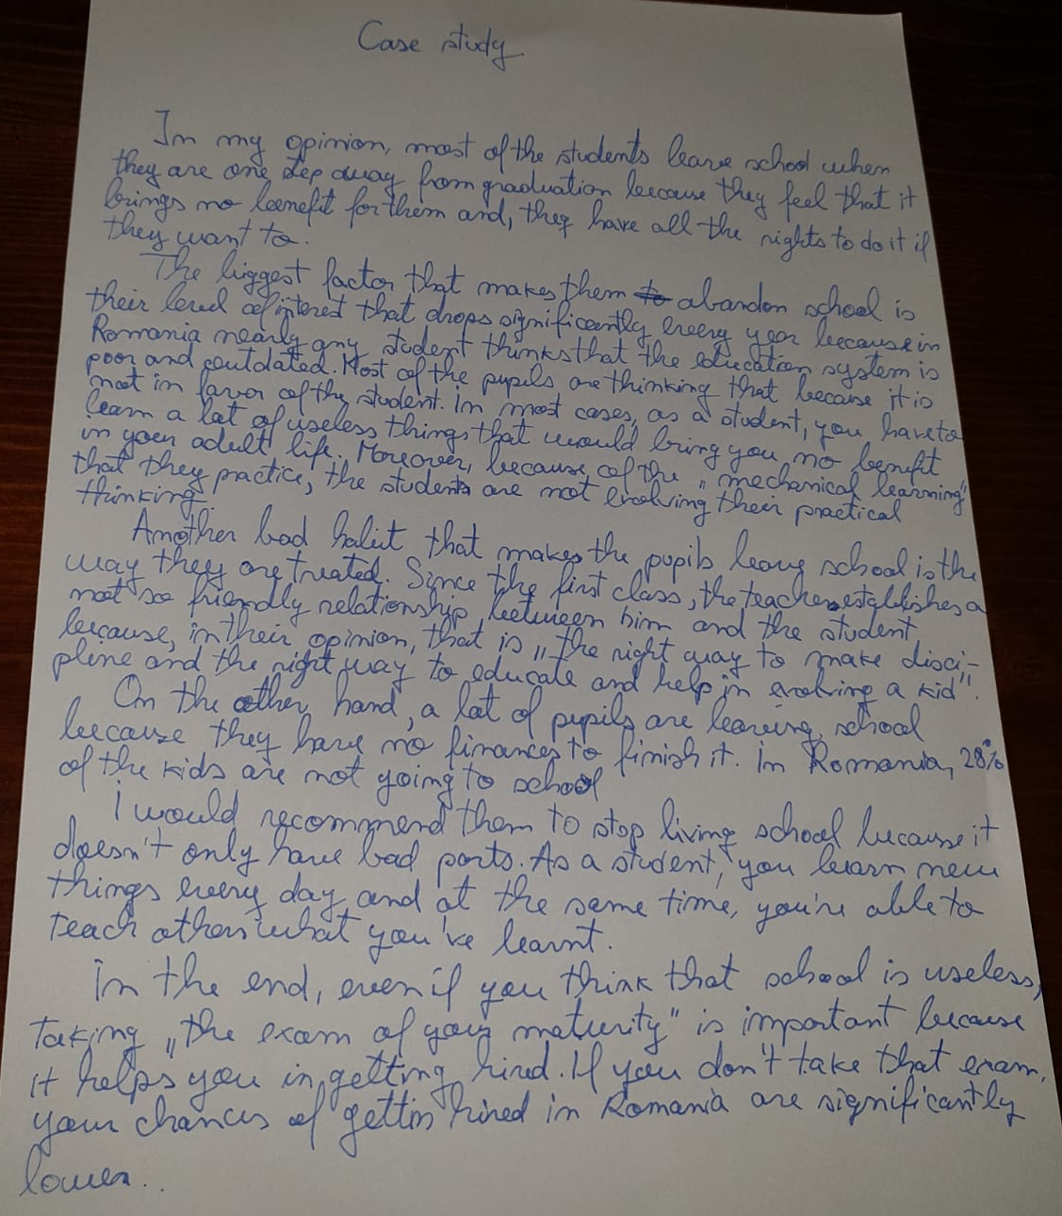
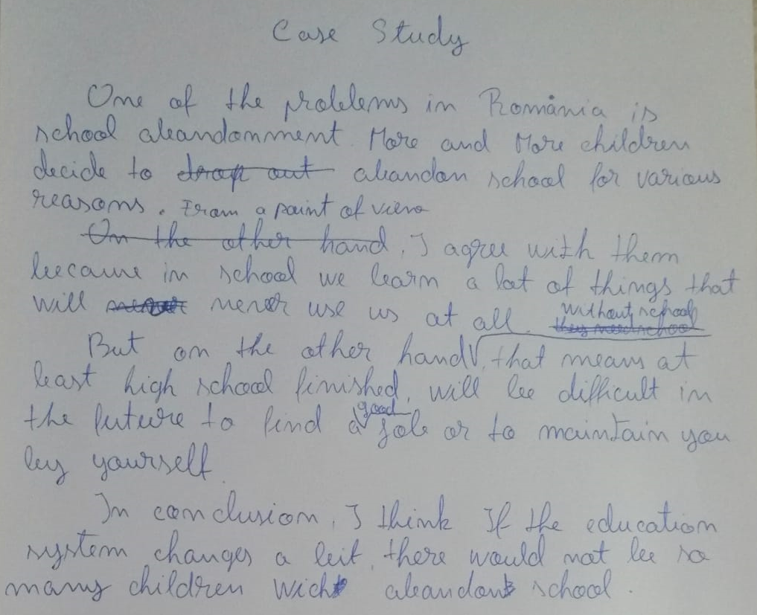

Slide 13
