Slide 1

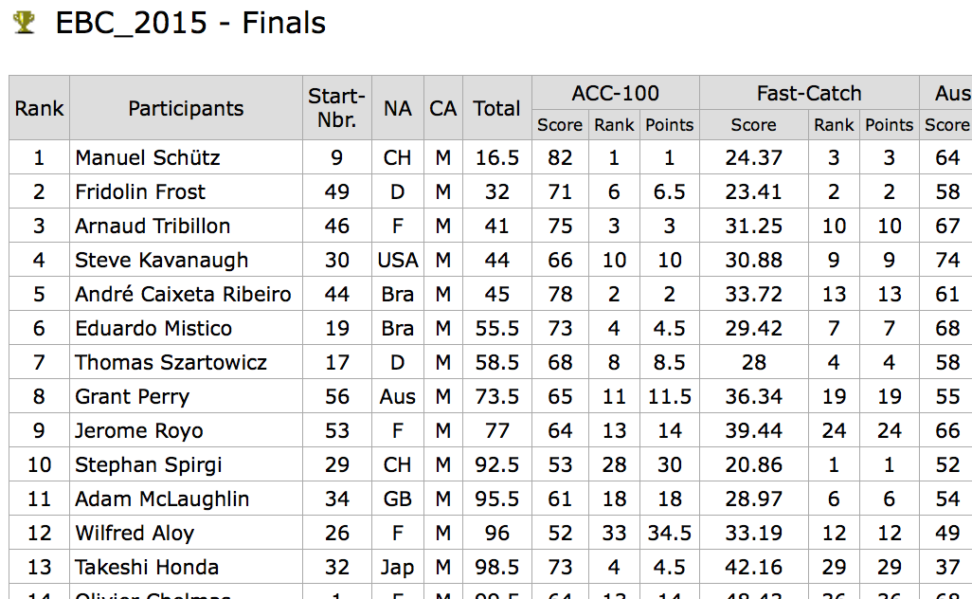
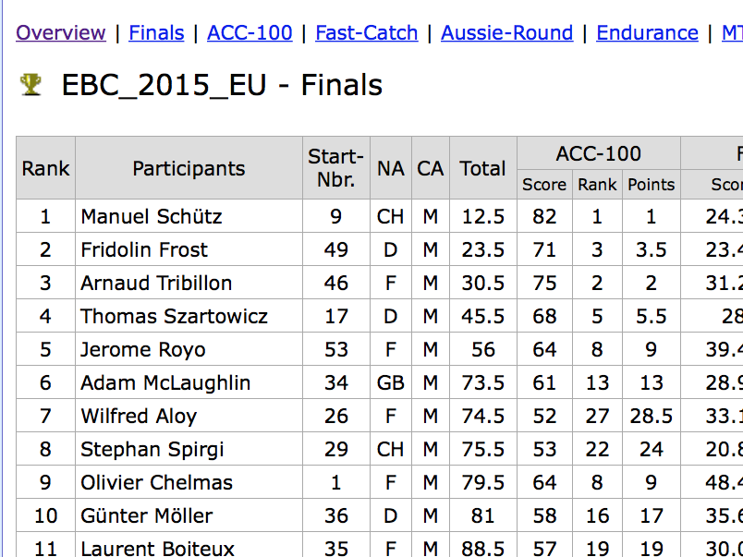
Rankings in multi-sport events
....like boomerang throwing

Slide 2
Thanks!
Oli Thienhaus: „If a new scoring system brings us 100 beginners, I‘m in“.
Alex Opri:“Why do we need a change? Current system is simple....“
Olivier Chelmas for sharing his thoughts.
Bill Hirst, Heiko Deiss, and others who help to think...

Slide 3
What it‘s is (not) about
Not about: Varying wind
(problem for ANY scoring system!! Idea: Seeding groups. Different topic)
What it‘s about: Thinking about how to score!
Motto: „The best prevents us from getting better“

Slide 4
Content
Requirements for a system to be fair
Situation now
Finding an alternative scoring system
Outlook

Slide 5
1. Requirements
A) Improvements of a score: Reward at any level of skill.
Example: Fast Catch
If an improvement from 28s to 23s gets an additional 10 (ranking) points
What about an improvement from 23s to 18s?
We agree: at least +10p
B) System has to be transparent.
a) It‘s clear what the assumptions are (axioms)
Example: Ranking points measure how many competitors you beat.
b) Generalists should win over specialists.
c) Impact/weight of each event on overall rank must be equal.

Slide 6
2. Situation right now
System = Simple: Lowest sum of ranking points wins
...errr: Why can we add ranks?
Assume we have:
A scores 77p in ACC (Rank 5) and 20.00s in FC (Rank 1)
B scores 80p in ACC (Rank 2) and 29.00s in FC (Rank 4)
Both get 5+1=2+4 = 6 Ranking points. It‘s a tie
We agree?: A was the better thrower.
So: What does the actual system measure?....

Slide 7
2. Situation right now
Yes, how many throwers you have beaten.
But: We don‘t compete head to head, up to the final.
It‘s more like a decathlon!
5+1=2+4 is true only if we assume that the distance between each rank is the same (mathematically: No addition without a metric).
Consider some Fast Catch results from WBC2008:
score
rank
Based on the metric of our system:
The gap between 16.80s and 18.74s (ca. 2.0s, 5 ranks)
The gap between 21.22s and 21.68s (ca. 0.5s, 5 ranks) !!!
The gap between 38.62s and 44.25s (ca. 5.5s, 5 ranks)
That‘s at least questionable...
16.8 | 17.41 | 17.88 | 18.74 | 19.88 | 21.22 | 21.68 | 22.51 | 38.62 | 44.25
1 | 2 | 3 | 6 | 11 | 16 | 21 | 26 | 76 | 81

Slide 8
2. Situation right now
„Salary“ 13.5 p
Improvement 10 p
„Salary“ 35 p
„Salary“ 1 p
Improvement 10 p
Improvement 10 p
Conclusion: Exceptional performances at the lower end and upper end of the scale are very clearly underrated.
-> Frustrating for beginners: You improve, still LAST.
-> Frustrating for top throwers: Exceptional score, still can‘t make up points on opponents

Slide 9
1. Requirements
Point A:
Favours improvements in the middle part of the scores.
A) Improvements of a score: Reward at any level of skill.
Example: Fast Catch
If an improvement from 28s to 23s gets an additional 10 (ranking) points
What about an improvement from 23s to 18s? We agree: at least +10p
B) System has to be transparent.
a) It‘s clear what the assumptions are (axioms)
Example: Ranking points measure how many competitors you beat.
b) Generalists should win over specialists in certain events.
c) Impact of each event on overall rank must be equal.
Point B:b and c:
Specialists for events where scores are very tight have an advantage. (FC vs ACC at WBC2008
The IAAF abandoned rank position sums for the decathlon in 1908...

Slide 10
3. Relative scoring system
First idea: Linear point table. Example Fast Catch:
Not very good...
WHY? An improvement of 5s becomes more and more difficult, say impossible.
Second attempt, more reasonable (?):
60s | 50s | 40s | 30s | 25s | 20s | 15s | 10s | 5s | 0s
40p | 50p | 60p | 70p | 75p | 80p | 85p | 90p | 95p | 100p
60s | 50s | 40s | 30s | 25s | 20s | 15s | 10s | 5s | 0s
25p | 30p | 37.5p | 50p | 60p | 75p | 100p | 150p | 300p | infinite

Slide 11
3. Relative scoring system
So what do we know?
1. The lowest possible score is 1 catch for FC and END, 1 p for ACC, ca. 4s for MTA, 2p for TC and 3p for AR.
2. The highest possible score for ACC and AR and TC is 100p (apart from tiebreaks for >100p). Fast Catch: 15.00s END: 80c.
MTA: Without thermals maybe 50s?
3. We know APPROXIMATELY that 20s in FC is double as good as 40s etc.
That‘s a „ratio scale“ which allows multiplication of numbers.

Slide 12
3. Relative scoring system
Ratio scale works for Accuracy as well!
red double as good
as blue
score of 40p tells us:
4m on average.
score of 80p tells us:
8m on average.
4
8
0 2 4 6 8 10
„zero points at 11m-line“

Slide 13
3. Relative scoring system
Axioms for a new scoring system:
There is always a minimum nonzero score (2p in TC, 3p in AR, 4s in MTA, 1c in FC...).
We can measure if someone is double as fast or double as accurate as another.
(example ACC: 80p vs 40p or 8m vs 4m)
If in event 1 A is 2x better than B and in event 2 A is 1.5x better than B: Then A is 3x better overall. (1.5 x 2, not 1.5+2)
=> multiply points of all events! (Actually the geometric mean)
Difficult? Prefer to add numbers?
Possible! I will show you...

Slide 14
3. Relative scoring system
Example of a very small competition under varying conditions.
FC ACC AR END MTA TC
A is 2x | 0.5x| 0.93x| 1.5x|1.25x | 0.5x better than B
So overall A is 2 x 0.5 x 0.93 x 1.5 x 1.25 x 0.5 = 0.875 x as good as B.
B beats A, even if there are 100 additional competitors to come!
What would change if in TC we have 48p vs 96p? Yes: Nothing!
*MTA: The best score reachable without thermals is 50-60s. To be discussed. So every score over 50s is trunctuated to 50s=100p.
Trick Catch: If we see 533p, 107p, 100p we give 102,101,100p
A | 30.0s | 40p | 70p | 60c | 60s=>50s* | 12p
B | 60.0s | 80p | 75p | 40p | 40s | 24p

Slide 15
3. Relative scoring system
Is this system biased due to varying wind condition?
(very extreme example...) No if we multiply. Yes if we add.
Example: Fast Catch AR Multiply Add
A FC-specialist 4c = 20P 50p=50P 20x50=1000 20+50=70
B AR-specialist 2c = 10P 90p=90P 10x90=900 10+90=100
A wins B wins!
same throwers, reversed conditions
Example: Fast Catch AR Multiply Add A FC-specialist 16.5s = 90P 10p=10P 90x10=900 90+10=100
B AR-specialist 33.0s = 45P 18p=18P 45x18=810 45+18=63
A wins A wins

Slide 16
3. Relative scoring system
What if we WANT to add points? No problem: We create tables.
2 x score means ca. + 150 p, 20% better is ca. + 40 p, 10% better is ca. +20p
anywhere!
FC MTA END Rest: Similar
15.00s | 1000p
18.00s | 961p
21.00s | 927p
24.00s | 898p
27.00s | 873p
30.00s | 850p
37.80s | 800p
60.00s | 700p
4c(75s) | 652p
2c(150s) | 502p
0c(---s) | 350p
>=50s | 1000p
45s | 977p
40s | 952p
33s | 910p
30s | 889p
25s | 850p
20s | 802p
15s | 739p
10s | 652p
5s | 502p
<=4s | 451p
80c | 1000p
73c | 980p
65c | 955p
57c | 927p
48c | 889p
40c | 850p
32c | 802p
24c | 739p
16c | 652p
8c | 502p
0c | 50p

Slide 17
3. Relative scoring system
If we want to add points we have:
FC ACC AR END MTA TC
Transparence of the system: After the 4th event END
A has 3513 overall
B has 3488 overall
So B knows: „I‘m 25 behind‘‘. So a score ca 10% better than A is needed.
If A scores 40s in MTA, B needs ca. 45s to catch up. 952+25=977 needed.
INDEPENDENT OF WHO ELSE‘S SCORE IS BETWEEN A and B!
A | 30s=850 | 40P=802 | 70P=923 | 60c=938 | 40s=952
B | 60s=700 | 80P=952 | 75P=938 | 50c=898 | 45s=977

Slide 18
3. Relative scoring system
Possible advantages:
1. To improve is important at any level. So in TC it‘s IMPORTANT to have 20p instead of 10p!
Not the case currently unless wind is at 50km/h...
2. You always know how much better you need to be in the next event. Not the case with ranks.
3. Throwers compete against their direct opponent.
4. It can‘t happen anymore that you have (almost) won a tournament after 5/6 events! Generalists are favoured.

Slide 19
3. Relative scoring system
Possible disadvantages:
1. Yes, you need to calculate. But there are Apps... or
You need excel for evaluation. But hey.... Who wants to compute ranks even now without excel??
2. Only in MTA/END/FC you can chose risk/safety and may need to check the tables. Needs time to get used to it.
But: If you know how to make a boomerang you will be able to read these point tables!
Or are b.throwers less intelligent than decathletes? ☺

Slide 20
3. Relative scoring system
How to treat zero values
They can not be zero, since 0 x the rest of the events equals 0.
Idea: Take the minimum possible score in an event, 1c in Fast Catch
Since 1c was in 60s we can expect that the thrower finishes in 5c=300s
So 300s is the minimum score. (150s for 2c etc)
We simply define zeros and np as 99% and 99% of 99% = ca. 98% of the lowest possible score. (or 50% resp 25%? To be discussed)
0c = 300s x 100/99 = 303.03s
np = 303.03 x 100/99 = 306.09s
So on our table: (1c = 352p)
0c = 150/LN(2)*LN(15/303.03)+1000 = 350p
np = 150/LN(2)*LN(15/306.09)+1000 = 347p

Slide 21
4. Outlook
It‘s possible that this system has a bias for some events.
If yes: What‘s the possible reason?
-If scores scatter from 0p to 100p: High impact possible.
-If scores scatter from 50p to 100p, Impact on overall probably lower.
-If scores scatter from 70-80p, impact should be low. Current system doesn‘t distinguish: 70p = last place = n points.
Fact is: Events have different difficulty/skill levels.
Advantage: Events can be „designed“ for beginners!
Example: Catch 10/10 we would see scores of 8-10
But: Even if this possible bias is undesired: Point tables can be weighted/adjusted, but not rank sums.

Slide 22
Appendix: Mathematics
using the logarithm we transform multiplications of two scores x and y to a simple addition:
LN(x*y) = LN(x)+LN(y)
If we want 150 additional points per doubling of the score we get:
Points = 1000 + 150/LN(2)*LN(Score/Max_Score) when bigger is better
and
Points = 1000 + 150/LN(2)*LN(Min_Score/Score) when smaller is better
LN is the natural logarithm.
(Can also be calibrated to have A additional points per p% improvement...
Points = 1000 + A/LN(1+p/100)*LN(Score/Max_Score) )

Slide 23
2. Situation right now
„Salary“ 4 p
Improvement 5 p
„Salary“ 19 p
Improvement 5 p
„Salary“ 1 p
Improvement 5p

Slide 24
2. Situation right now
„Salary“ 2 p
Improvement 15 c
Number of throwers you beat
„Salary“ 6 p
Improvement 10 c
„Salary“ 3 p
Improvement 10 c

Slide 25
2. ..Relative scoring
„Salary“ 50 p
Improvement 15 c
Improvement 10 c
„Salary“ 70 p
„Salary“ 50 p
Points you get
Improvement 10 c

Slide 26
2. ..Relative scoring
Exceptional scores get extra points. Encouraging high performances

Slide 27
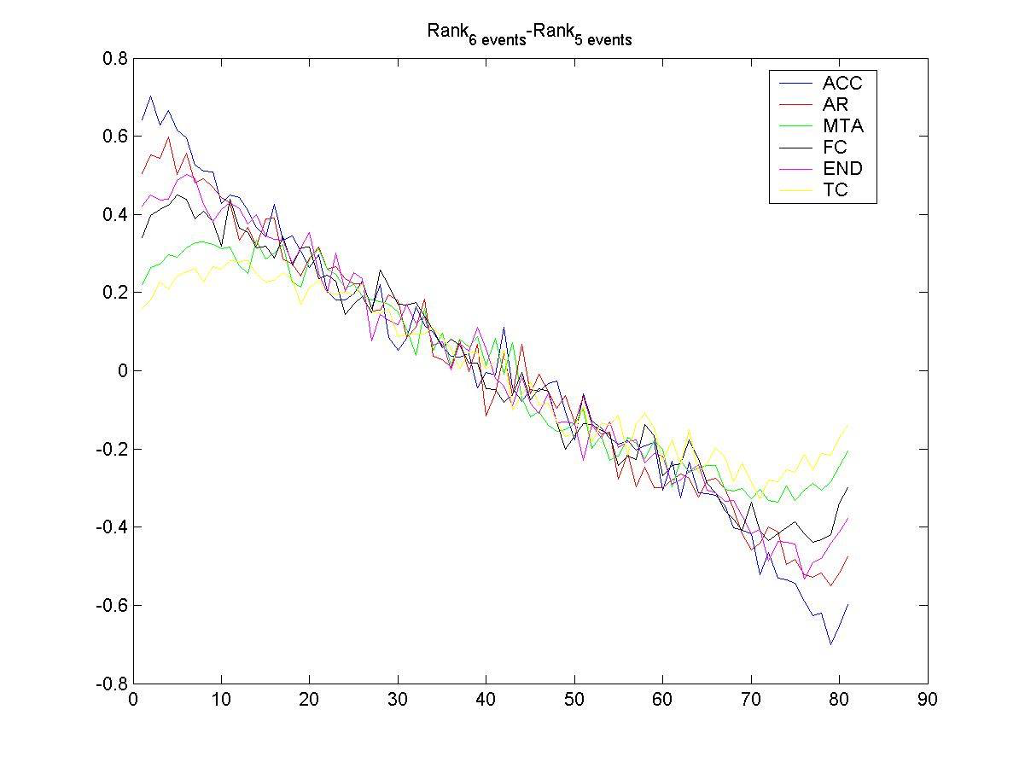
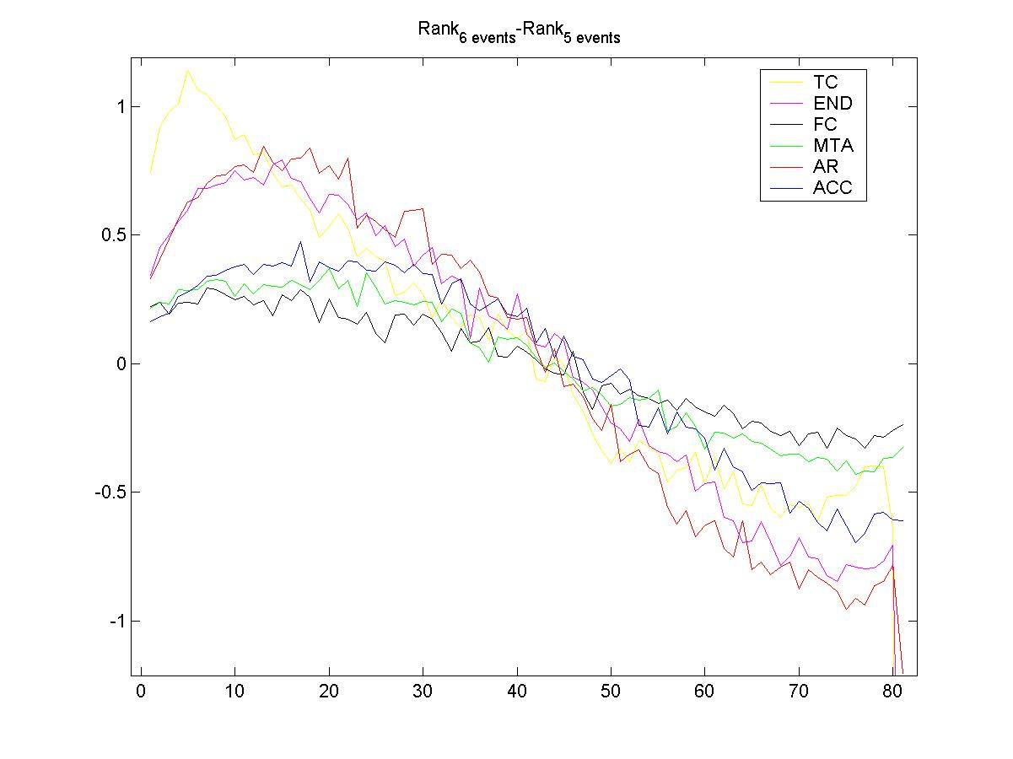
2. ..Relative scoring
Köln EBC05, MC Simulation.
Influence of 1 event on the final rank, Ranking points
Köln EBC05, MC Simulation.
Influence of 1 event on the final rank, Relative scoring
Tendency: Big influence if scores are
close to each other! (ACC/AR/END)
Tendency: Big influence if scores are
more scattered! (TC/END/AR)

