Slide 1
This is my personal job for an Erasmus + project.
More specifically , it is about a house transformation , from a warehouse to a neoclassical . The following project includes pictures with a small description!

Slide 2
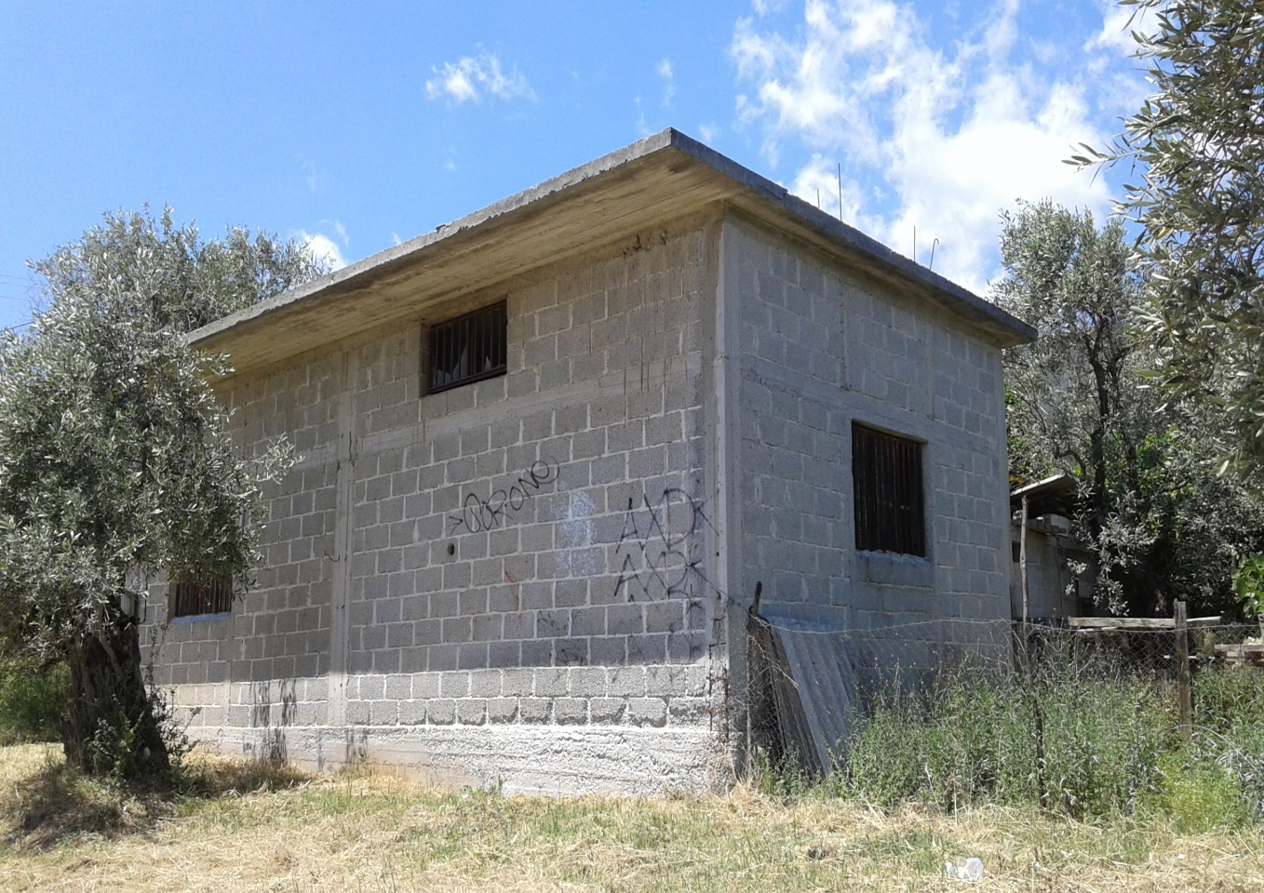
Before…
The house before was a warehouse. It is located at Lechonia (near the sea) . As we can see at this picture , the construction is made from concrete bricks.

Slide 3
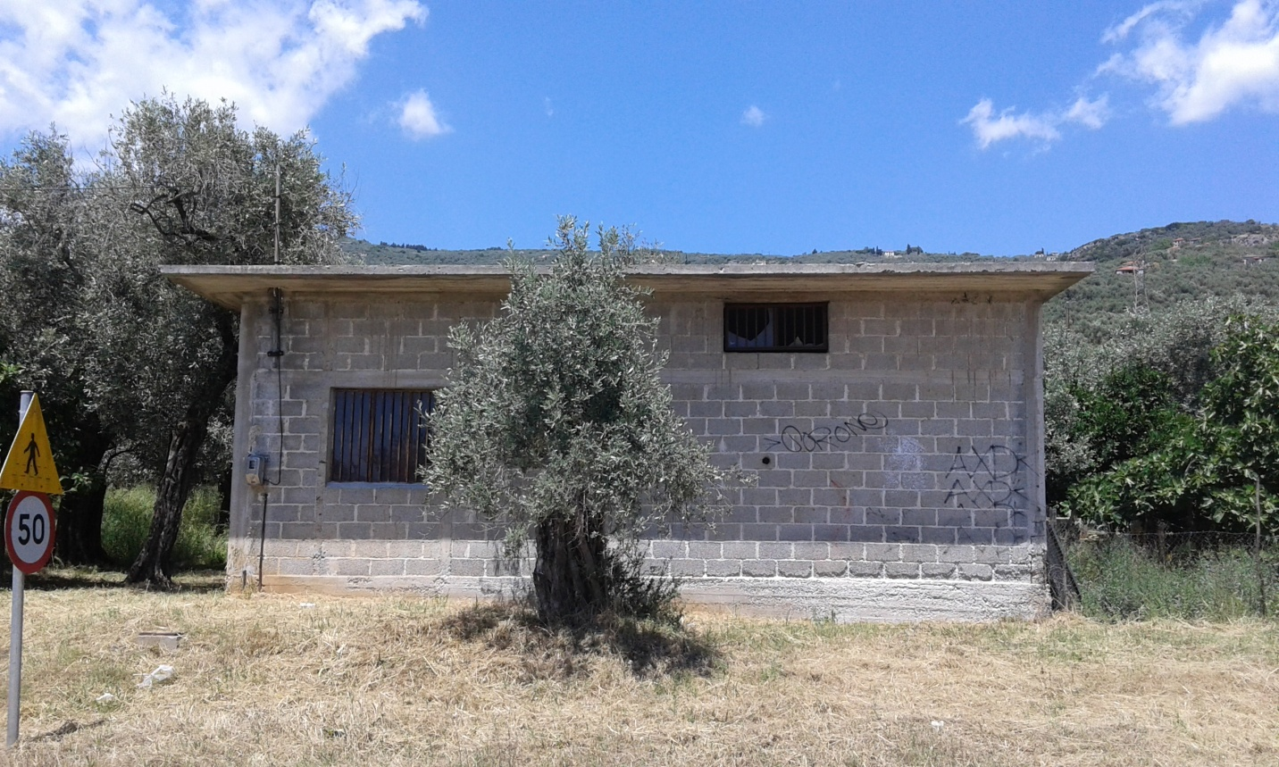
The front side
As it seems from the front side of the house , there is not roof . This fact should change , because the warehouse cannot consort with the rest of the region .

Slide 4
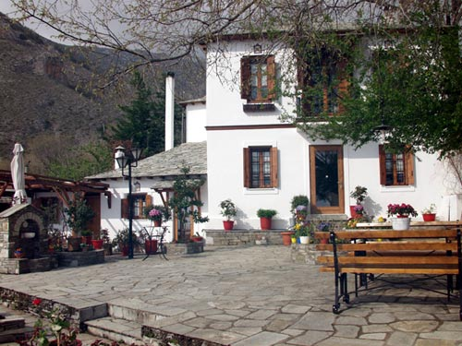
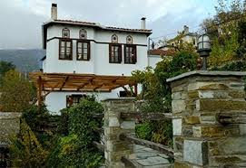
The architecture
Generally , the architecture of this house does not go with the rest . Lechonia follows the traditional Pelion architecture . The Pelion’s mansions have unique and natively characteristics . For instance , wooden windows , roof made of tiles and the characteristic design ( above windows and the main door).

Slide 5
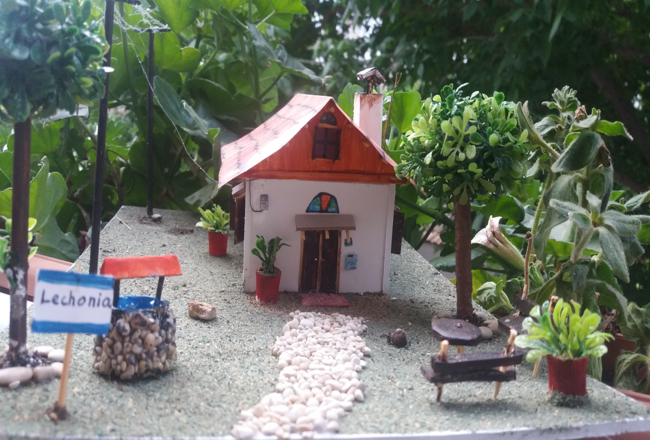
After…
The new construction created from original materials , like wood , tiles and stones . As we can see the only thing which remains is the feeders electricity.

Slide 6
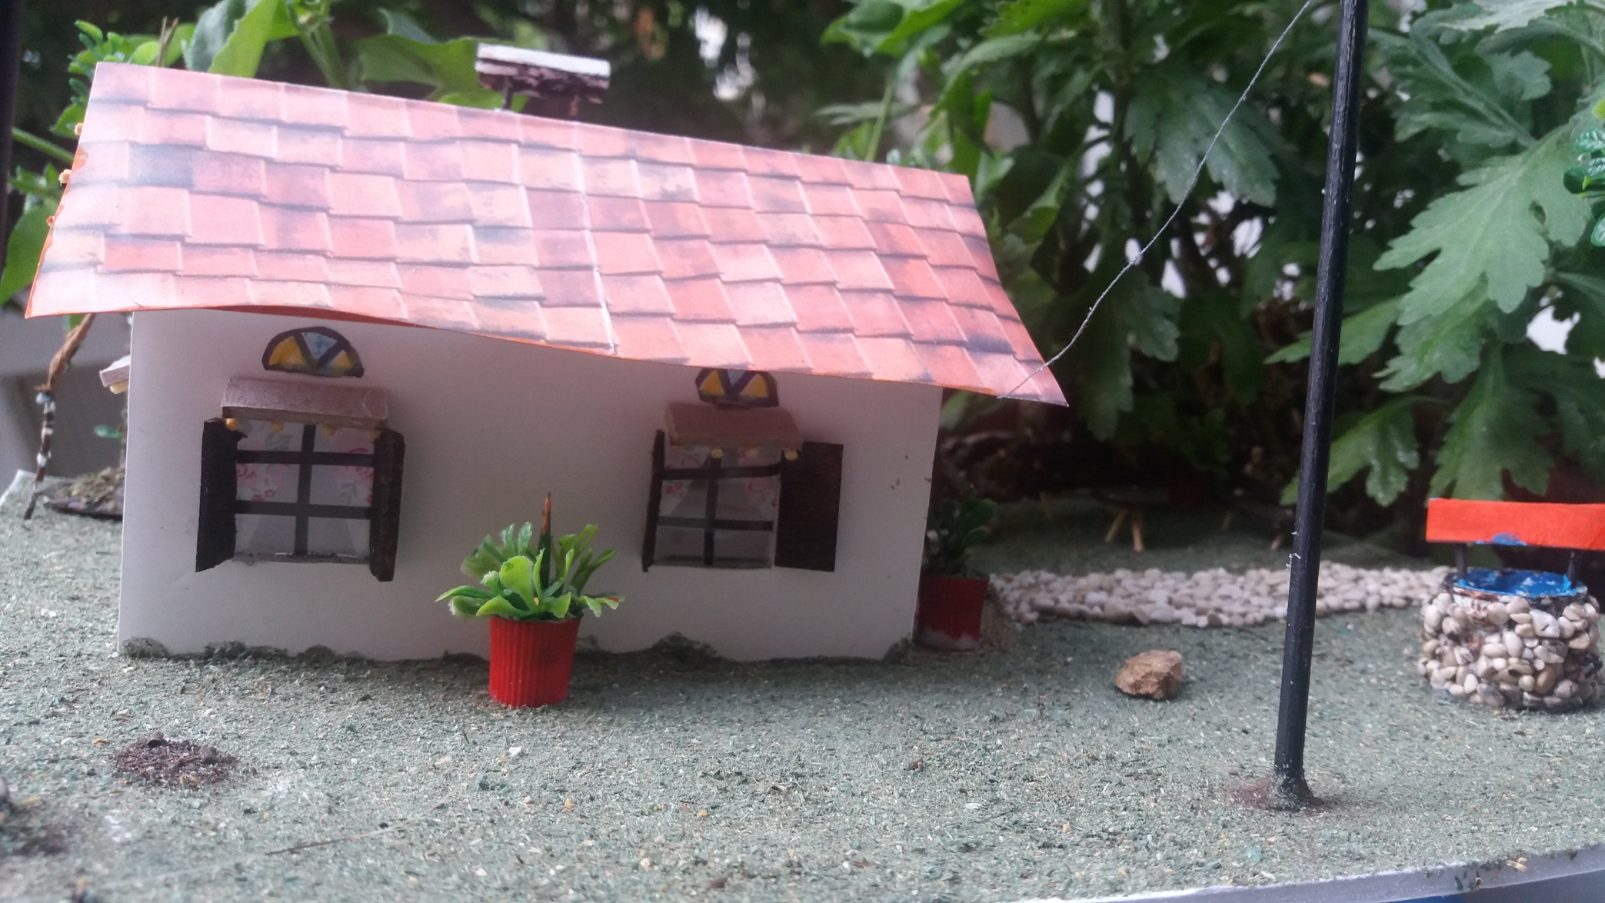
The other side…

