Slide 1
The construction sector of Indonesia
Ansumoudine MOHAMED
3rd year Civil engineering & infrastructure
University of Cergy Pontoise

Slide 2
Plan
Overview of National Economy
Main Economic indicators
Executive summary of the construction sector
Majors investment sectors
Main actors
Infrastructure development

Slide 3
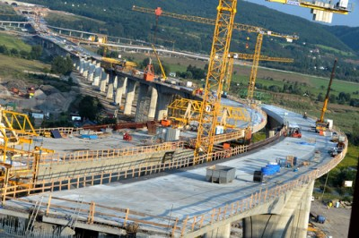
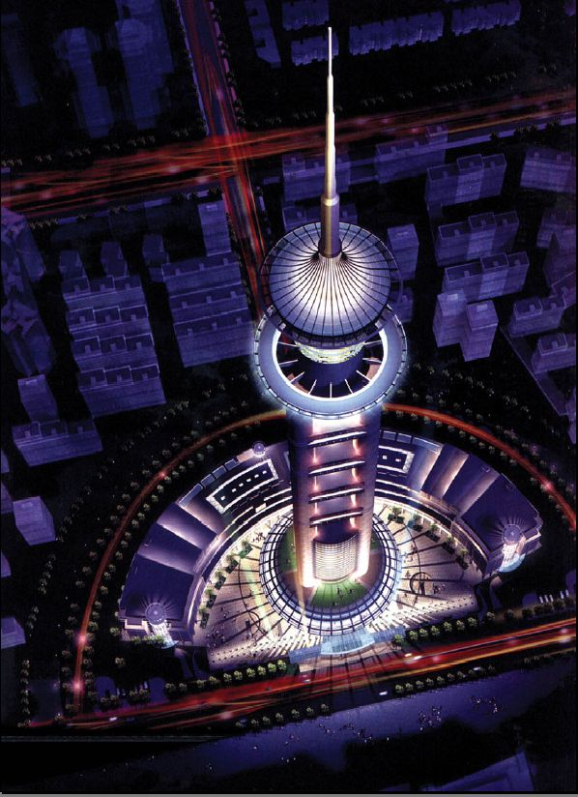
Jakarta Tower

Slide 4
Overview of National Economy
The Indonesian economy is growing significantly since it was hit by Asia economic crisis in 1997 and global financial crisis in 2008.
Now it is considered to be in stable state and to growth at 6.06% (2008) but it slightly decreases at 4.5% (2009) and then increase 6.10% (2010).

Slide 5
Main Economic Indicators
indicators | 2006 | 2007 | 2008 | 2009 | 2010 | 2011
Economic Growth (%) | 5,50 | 6,28 | 6,06 | 4,5 | 6 | 6
Construction Growth (%) | 9,00 | 10,40 | 10,50 | 7,95 | 7,3 | 7-8
Inflation (%) | 6,60 | 6,59 | 11,06 | 2,78 | 6,96 | 4,42
Foreign Exchange (Rp/US$) | 9,167 | 9,300 | 10,895 | 9,353 | 8,946 | 9,010
CBC-3 Months (%) | 9,75 | 8,50 | 8,67 | 7,36 | 7,25 | 7,25
Oil Price (US$/barrel) | 64,00 | 94,00 | 99,40 | 61,7 | 85 | 106,4
Source: Central Bank of Indonesia, Finance Ministry of RI, www.oilprice.net (2011)

Slide 6
I. Executive Summary of the construction sector
Economic growth of Indonesia has increased from 4.5% in 2009 to 6.10% in 2010. It is expected this year (2011) is about 6.5% (CBS, 2011).
The contribution of construction sector to GDP is IDR 660,967.5 Billion (2010) based on current price and IDR 150,063.3 Billion
(2010) under constant price (2000).
The construction investment has changed from 8.5% (2007), 7.5% (2008), 7.1% (2009) and 7.0% (2010).
In the next following years until 2014, the volume of construction market will increase dramatically.

Slide 7
Under the new master plan of economic development
(2011 – 2025), the Government estimates almost IDR 1,923.
7 Trillion of infrastructure investment to boost economic growth under the new six economic corridors across archipelago (MP3EI, 2011).
For the fiscal year 2011, the government spending for infrastructure provision accounts for almost IDR 140 Trillion and the next coming year accounts for IDR 180 Trillion (2012) in which public work projects covering road networks, water resources and human settlement will get the public funding almost IDR 62 Trillion (2012).

Slide 8
II. Major Investment sectors
The Government of Indonesia has expressed her desire to speed up infrastructure development in order to accelerate economic growth to levels of 7.8% through increasing the ratio of Investment to GDP to 28.4% from 19.6%, opening new job opportunities to reduce unemployment and poverty
alleviation to 5.1% and 8.2%.
The above investment driven development plan can be seen in the following table which depicts infrastructure demand between 2010-2014 to be IDR 1,923.7 Trillion or US$ 209.949 Billion.

Slide 9
Infrastructure Fund by Central Government (IDR Trillion)
Source: RPJMN

Slide 10
A more accurate picture can be obtained in the following tables which illustrate Ready for Offer PPP Projects.

Slide 11
Projects already tendered
No | Projects | Investment estimation (US$ Million)
1 | Central Java Coal Fired System Power Plant | 3 000, 00
2 | Soekarna Hatta Airport – Manggaral Railway | 1 100, 00
3 | Umbulan Water Supply | 240,20
4 | Purukcahu – Bangkuang Coal Railway | 2 100,00
5 | Jakarta Monorail | 475,00

Slide 12
Projects not yet tendered
No | Projects | Investment estimation (US$ Million)
6 | Southern Banten Airport | 213,61
7 | Expansion of Tanjung Priok Port, Kalibaru, DKI Jakarta | 1 170, 20
8 | Tanah Ampo Cruise Terminal | 28,30
9 | Medan - Kuala Namu – Tebing Tinggi Toll Road | 670,40
10 | Sunda Strait Bridge | 25 000,00
11 | Bandar Lampung Municipal water Supply, Lampung | 38,00
12 | Jatiluhur Water Supply | 189,30

Slide 13
No | Projects | Investment estimation (US$ Million)
13 | Pondok Gede Water Supply | 22,40
14 | Surakarta Water Supply, Bekasi, West Java | 6,74
15 | Southern Bali Water Treatment Facility | 43,50
16 | Maros Water Supply | 11,50
17 | Bandung Solid Waste Management | 100,00
18 | Surakarta Solid Waste Management | 30,00
Source: PPP Books (2011)

Slide 14
Public works investment is one of key government plan to deliver roads, water resources and human settlement infrastructures.
See the following table witch include
Roads
Bridges
water Resources
human settlements

Slide 15
Public works investment plan (2010 – 2011) (IDR Trillion)
No | Public Works | YEAR |  |  |  |  | Total
 |  | 2010 | 2011 | 2012 | 2013 | 2014
1 | Water Ressources | 11,468 | 14,908 | 19,320 | 25,125 | 32,679 | 103,500
2 | Roads | 20,102 | 24,360 | 30,033 | 37,061 | 45,344 | 156,900
3 | Human Settlements | 9,081 | 11,033 | 13,413 | 15,964 | 19,509 | 69,000
Source: Center for Strategic Studies, the Ministry of Public Works (2010)

Slide 16
To avert a looming power crisis in the energy sector and develop the domestic gas market, substantial investments, close to $25 billion in the power sector and $3-4 in the downstream gas sector, are required.
The following table represents value of Construction Completed by Type of Construction 2006 – 2011 Based on Contract Price (CBS, 2011)

Slide 17
Value of Construction
Construction | 2006 | 2007 | 2008 | 2009 | 2010 | 2011
Residential | 9 305 172 | 9 305 172 | 11 2363 484 | 12 448 707 | 13 758 648 | 15 206 431
Non residential | 22 069 558 | 23 528 407 | 29 613 637 | 34 421 939 | 40 010 954 | 46 507 445
Electrical Installation | 3 363 393 | 3 563 451 | 3 775 409 | 3 999 974 | 4 237 897 | 4 489 972
Gas and Water Supply installation | 371,544 | 319,911 | 275 453 | 237,173 | 204,214 | 175,834
Ect | … | … | … | … | … | …
Total | 71 943 309 | 79 391 287 | 94 484 668 | 111 988 121 | 135 743665 | 169 697259
Source: SBC (2009)

Slide 18
III. Main actors
The largest companies in the sector are SOEs such as PT Adhi Karya Tbk (Persero) and PT Wijaya Karya Tbk (Persero) which are far more successful in being awarded state contracts than private competitors.
Foreign companies seeking a local partner must consider factors outside of just skill and size; local contractors who have the political connections needed for state funded construction projects are the most advantageous category of partner to take advantage.

Slide 19
There are the private sectors, including 72 foreign contractors like Leighton Holdings Ltd, Kajima, Daewo Engineering, China Communications Construction and etc
Current figure shows that most foreign construction companies in Indonesia come from Japan, followed by US, China and then Europe

Slide 20
IV. Infrastructure Development
To ensure that economic growth can rise to its potential infrastructure development is vital, more toll roads, power plants, railways, bridges and tunnels and improved harbours and airports, water & sanitation are needed, not only to create employment (and stimulate consumer spending), but also to attract private investment. Plans to upgrade Indonesia’s infrastructure are expected to attract US$70 Billion of investment over the next 5 years stimulating a boom in the construction industry that is expected to grow at over 6.8% year on year.

Slide 21
The End

