Slide 1
WIKA – Wijaya Karya
Ansumoudine MOHAMED
3rd year Civil engineering & infrastructure
University of Cergy Pontoise
Indonesia’s Leading Integrated EPC & Investment Company
Multi-talented construction company

Slide 2
Plan
Presentation
Executive Summary
Group of companies
Management Strategy
Business Unit
Projects In Progress
Investor Relation
Financials

Slide 3
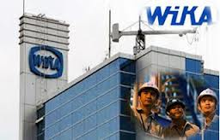
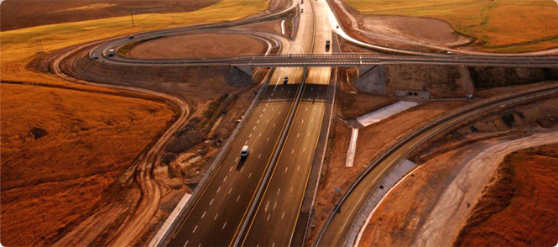
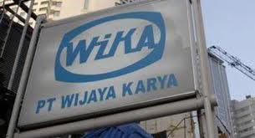
I. Presentation

Slide 4
A. Executive summary
PT Wijaya Karya Tbk. (WIKA), with the 52-year experience, is the most growing company in infrastructure
industry. WIKA has a unique and complete set of competence to become a construction company with an
integration in concrete industry, realty and trading with national and international reputation. WIKA’s pride
itself in becoming a contractor of projects equivalent to Power Plants in Cilacap and Cilegon, Cipularang Toll
Bridge, Sommerset and Bellezza Apartments, Cement Plant 8 Indocement Project, and several others.

Slide 5
WIKA grows to be an EPC project manager by acquiring specialties companies.
WIKA has been listed in IDX since October 2007 and use the capital market fund to finance its expansion in
EPC, power plant and toll road projects, and international construction projects.
Today, Wijaya Karya Persero Tbk PT, through its subsidiaries, offers construction services, manufactures building materials, and develops real estate. The Company constructs commercial and residential apartment buildings, rail transpor tation systems and bridges, and manufactures concrete products, energy conversion products, alloy component casting, furniture, and steel constrution.

Slide 6
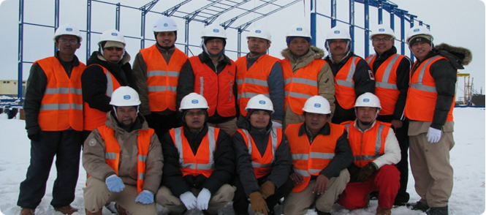
B. Group of Companies

Slide 7
PT WIJAYA KARYA Beton
PT WIJAYA KARYA Realty
PT Wijaya Karya Beton (WIKA BETON) as one of WIKA’s subsidiaries, established on March 11, 1997, is part of corporate expansion in pre-cast concrete industry.
Line of Business : Concrete Industry
PT Wijaya Karya Realty focuses its business in realty and property development that also covers consultancy services, planning, constructions and landscaping services. WIKA REALTY has developed several residential housings since 1985.
Line Of Business : Realty & Property

Slide 8
PT WIJAYA KARYA Intrade
PT WIJAYA KARYA Insan Pertiwi
PT Wijaya Karya Intrade is a subsidiary of PT WIKA which established from division merger between Metal Product Division and Trading Division of PT WIKA. Its objectives are : to give more focus on business management, to be more independent, and to achieve better performance.
Line Of Business : Industry and Trade
PT Wijaya Karya Insan Pertiwi (WIKA Insan Pertiwi) a subsidiary of WIKA, resulted from the acquisition of 70.08 percent shares of PT Catur Insan Pertiwi on November 2008. WIKA Insan Pertiwi specializes in the installation of mechanical electrical industrial and power plant projects.
Line of Business : Installation of Mechanical Electrical Industrial and Power Plant Projects

Slide 9
PT Wijaya Karya Bangunan Gedung
PT Wijaya Karya Jabar Power
PT Wijaya Karya Bangunan Gedung was officially established on 24 October 2008, in which WIKA holds 99% interests. WIKA Gedung started its operation with an authorised capital of Rp200 billion, and a paid-in capital of Rp50 billion with a share ownership composition of 99 percent by WIKA and 1 percent by the WIKA Employee Cooperatives.
Line of Business : Residential and Non-Residential Building Construction.
PT Wijaya Karya Jabar Power (WIKA Jabar Power) was established pursuant to the Notarial Deed by A.Budy Priahastyanti Surjaningsih, SH dated 16 July 2009, while its operations started only after the holding of its GMS on 6 November 2009. The Company holds 55 percent shares of WIKA Jabar Powe, PT Jasa Sarana holds 40 percent and PT Resources Jaya Teknik Management Indonesia holds 5 percent.
Line of Business : Power Plant Projects.

Slide 10
C. Management Strategy

Slide 11
The Forward Integration Strategy is demonstrated in the connection between the activities of WIKA’s main business with WIKA Realty, WIKA Jabar Power, as well as WIKA’s participation in the Surabaya-Mojokerto toll-road project in PT Marga Nujyasumo Agung and the Kunciran Cengkareng toll-road project in PT Marga Kunciran Cengkareng, where WIKA got the added value as a contractor and supporting the accelerating the execution of development on strategic projects that include investments in toll-road projects, IPP Power Plant, Oil and Gas, and Building Construction.

Slide 12
II. Business Unit
Civil Construction
Building Construction
Industrial Plant
Energy
Precast Industry
Real Estate
Other Industry & Trading

Slide 13
III. Projects In Progress

Slide 14
Projects examples by category

Slide 19
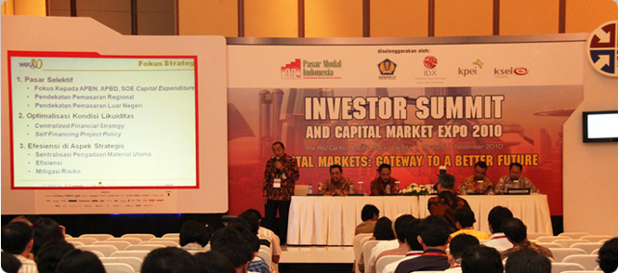
IV. Investor Relation

Slide 20
Shareholder

Slide 22
V. Financials

Slide 23
Balance Sheet

Slide 24
Income Statement

Slide 25
Cash flow Analysis

Slide 26
Key Ratios

Slide 27
The End

