Slide 1
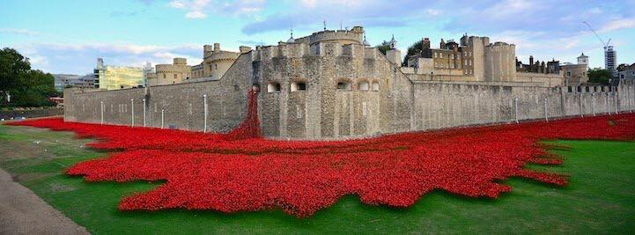
Look at the photos and describe what you can see
Do you recognize this monument ?
Where is it ?

Slide 2
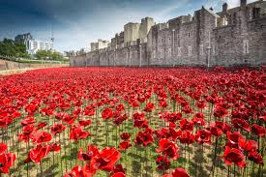
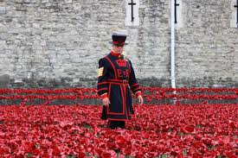

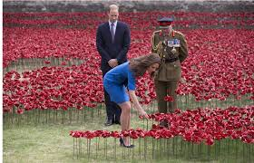
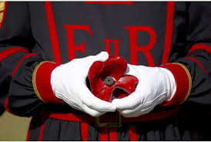
Who and what can you see ?
When ?
Why ?
A garden
A beefeater
A poppy / lots of poppies
A soldier
Vocab. Help :
Commemorate
Fall for the country
Armistice Day / Poppy day
Ceramic poppy
Sell / charity
Artists : Paul Cummings + Tom Piper
The Moat : les douves

Slide 3

Some figures about World War One…
Can you say them properly ?
You may need to use the passive form.

Slide 5
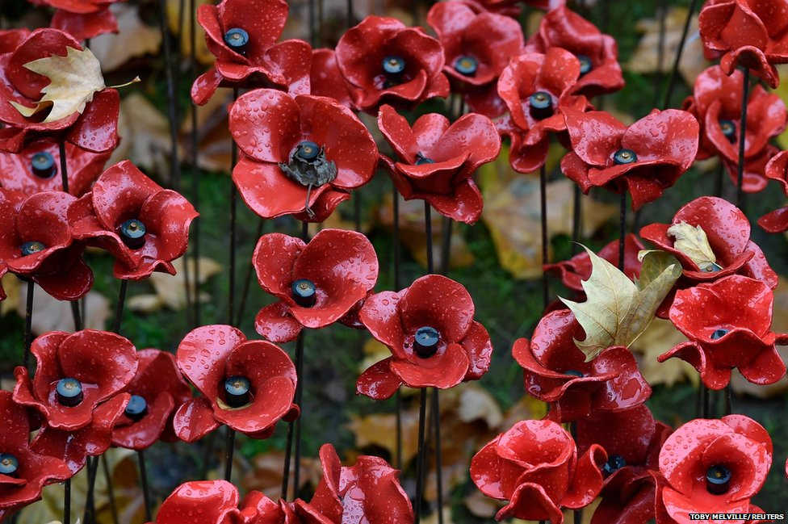


Read this text after listening to it (clic on the poppy) : pay attention to the intonation.
In the UK, 11 November is known as Remembrance day, Poppy Day or Armistice Day. World War I started in 1914 and ended in 1918.
In 2014, in order to commemorate the centenary of the war, 888,246 ceramic poppies have been planted in the Moat, at the Tower of London, each one representing a British or colonial soldier who has fallen for the country.
The poppies have been sold for charity.

Slide 6
For more information :
http://www.bbc.com/news/in-pictures-29935592
http://www.britishlegion.org.uk/remembrance/ww1-centenary/poppies-in-the-moat

