Slide 1
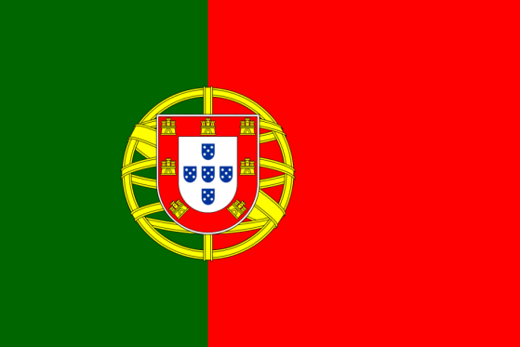
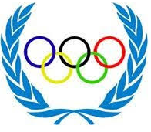
The Olympic Games
AGRUPAMENTO DE ESCOLAS DR. CORREIA MATEUS

Slide 2
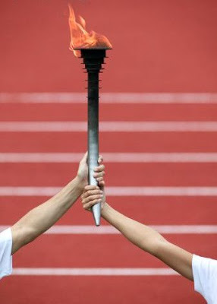
The Olympic Games
The Modern Olympic Games starts in 1896 in Athens. Greece was chosen as the birthplace of the Olympics in ancient times. These games was disputed four in four years, was only interrupted in 1916, 1942 and 1944, because of the world wars.

Slide 3
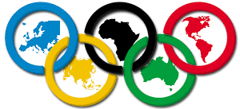
The symbol of the Olympic games
THE OLYMPIC GAMES
Of all the Olympic symbols, the Olympic Flag is the most important. It was created by Pierre de Coubertin in the games of Antwerp in 1920, to symbolize the union of the 5 continents.

Slide 4
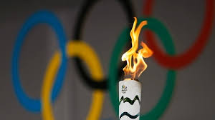
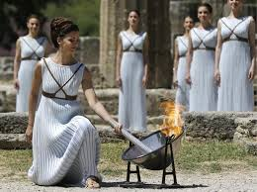
The Olympic Flame
THE OLYMPIC GAMES
The Olympic flame begins its journey to the games in the old Olympic in Greece, near the place where the participants prepared to start the games

Slide 5
ANCIENT OLYMPIC GAMES
THE OLYMPIC GAMES

Slide 6
The place where olympic games took place

Slide 7
THE OLYMPIC GAMES
Games | City | Honor | Period
Píticos Games (586 a.c.) | Delfos | Apolo | 4 in 4 years
Nemeus Games (573 a.c.) | Nemeia | Heracles | 2 in 2 years
Istmicos Games (581 a.c.) | Istmo de Corinto | Poseidon | 2 in 2 years
Olympic Games (776 a.c.) | Olimpia | Zeus | 4 in 4 years

Slide 8
THE OLYMPIC GAMES
GAMES PROGRAMME
Day 1 - Opening Ceremony
Day 2 - Performing the pentathlon (discus, javelin, running, fighting and jumping), the apologies to Pélope (goddess of fertility) and horse drawn carriages
Day 3 - Sacrifice to Jupiter, followed by races
Day 4 - Fight, pugilism and pancraze (free fight)
5th Day - distribution of prizes, official crowning of the winners thanks to the deities and banquet.

Slide 9
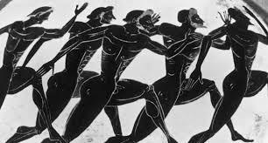
THE OLYMPIC GAMES
Victory:
Athlete; family; City
Famous; immortal
Honors: banquets; Statues
During the J.O., there was a sacred truce between cities that were at war.
Absolute peace during the games.

Slide 10
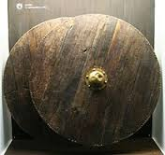
PRIZES
THE OLYMPIC GAMES
The winner of olympic games won:
Olive
Shields

Slide 11
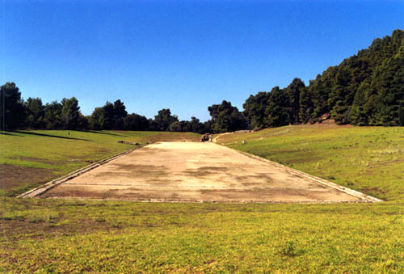
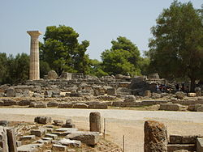
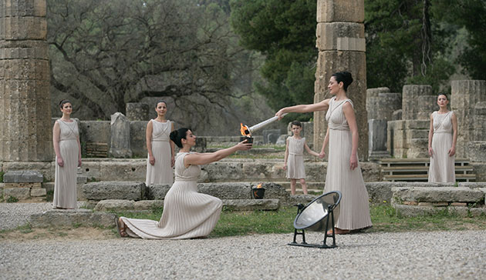
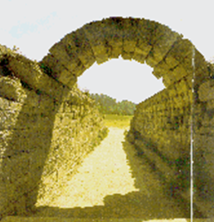
THE OLYMPIC GAMES
SPORTS FACILITIES
Held at Olympia
Rural site in the Western Peloponnese

Slide 12
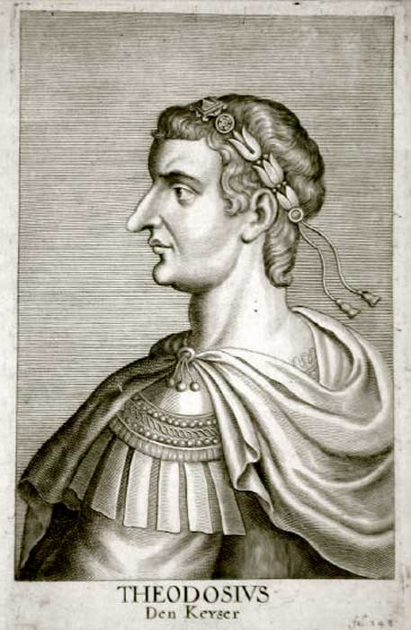
THE OLYMPIC GAMES
393 d.c. - Theodosius I (Roman emperor converted to Christianity) abolished the O.G. for being a pagan festival

Slide 13
MODERN OLYMPIC GAMES
THE OLYMPIC GAMES

Slide 14
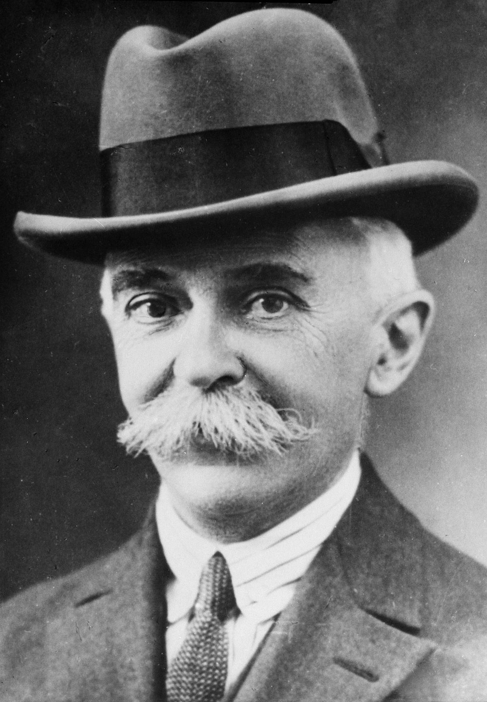
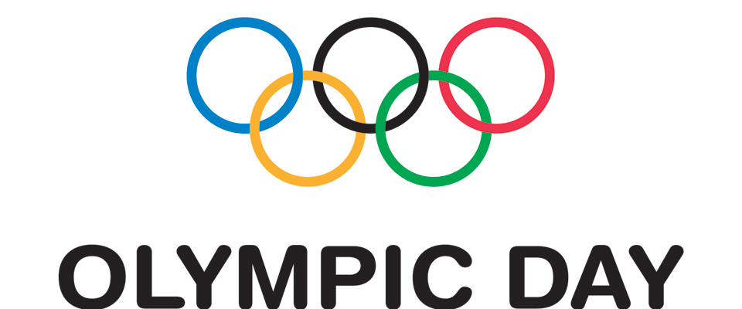
THE OLYMPIC GAMES
Pierre de Coubertin (1863-1937) - historian and sociologist was interested in the history of ancient Greece and was reborn the O.G.

Slide 15
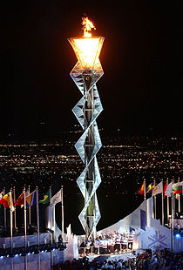
THE OLYMPIC GAMES
18 countries have already received the games, six of them for more than once (Germany, Australia, USA, France, Britain and Greece).
The United States is the country that has held the Olympics in its territory more than four times, and London is the only city that received three times the organization of the Olympic Games.
Portugal has never organized the Olympic Games

Slide 16
THE OLYMPIC GAMES
1896 - Athens (GRE)
1900 - Paris (FRA)
1904 - St. Louis (USA)
1908 - London (GBR)
1912 - Stockholm (SUE)
1920 - Antwerp (BEL)
1924 – Paris (FRA)
1928 – Amsterdam (NTH)
1932 – Los Angels (USA)
1936 – Berlin (GER)
1948 - London (GBR)
1952 - Helsinki (FIN)
1956 - Melbourne (AUS)
1960 - Rome (ITA
1964 - Tokyo (JAP)
1968 - Mexico City (MEX)
1972 - Munich (ALE)
1976 - Montreal (CAN)
1980 - Moscow (USSR)
1984 - Los Angeles (USA)
1988 - Seoul (KOR)
1992 - Barcelona (SPN)
1996 - Atlanta (USA)
2000 - Sydney (AUS)
2004 - Athens (GRE)
2008 - Beijing (CHN)
2012 - London (GBR)
2016 - Rio Janeiro (BRZ)

Slide 17
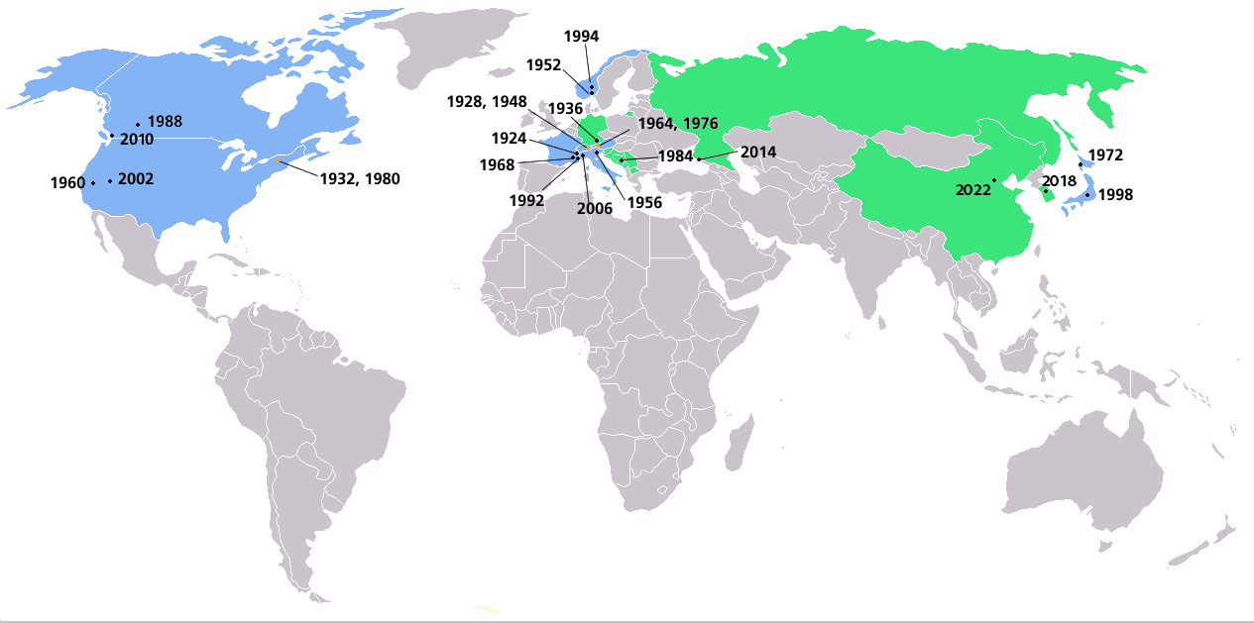
THE OLYMPIC GAMES

Slide 18
Work done by:
THE OLYMPIC GAMES
Inês Lopes , n 11
Íris Crespo , nº 12
João Arnauth , nº13

